Slide 1

ASPECTOS RELEVANTES EN EL MANEJO DEL PACIENTE CARDIOLOGICO
Anticoagulación en la FANV: casos clínicos.
Dr. Martín Ruiz Ortiz
Cardiólogo, Hospital Universitario Reina Sofía. Córdoba.
Secretario Grupo Trabajo Fibrilación Auricular
Sociedad Andaluza de Cardiología.
Coordinador Proceso Fibrilación Auricular
Proyecto SEC-EXCELENTE
Sociedad Española de Cardiología.

Slide 2
Anticoagulación en la FANV: casos clínicos.
Anticoagulación en el paciente frágil y anciano con fibrilación auricular
¿qué fármaco y qué dosis usar?
2. ¿Cuándo no deberíamos anticoagular una fibrilación auricular?
3. Fibrilación auricular e insuficiencia renal… ¿anticoagular o no anticoagular?
4. Fibrilación auricular y procedimientos invasivos o quirúrgicos ¿hay que suspender la anticoagulación siempre? ¿cuánto tiempo? ¿hay que usar terapia puente?
5. Anticoagulación y cardiopatía estructural ¿antagonistas de la vitamina K o anticoagulantes directos?
6. ¿Qué hacer ante un proceso hemorrágico? ¿Supresión o continuación?

Slide 3
Caso 1
Mujer de 78 años, hipertensa, intervenida de prótesis biológica aórtica en Septiembre 2007,
En 2015: Comienza con FA asintomática
La paciente tiene función renal normal, mide 166 cm y pesa 73 kg.
En tratamiento con Sintrom, pero sus INR en los 6 últimos meses son
1.7, 1.8, 2.9, 3.5, 3.1, 2.7 (sólo 2/6 en rango terapéutico, TRT por Rosendaal 45%)

Slide 4
Anticoagulación y cardiopatía estructural ¿antagonistas de la vitamina K o anticoagulantes directos?

Slide 5
Anticoagulación y cardiopatía estructural ¿antagonistas de la vitamina K o anticoagulantes directos?
Hindricks G. 2020 ESC guidelines for AF management. European Heart Journal 2020;42:373-498.

Slide 6
Steffel J. Eur Heart J 2018;39:1330-1393

Slide 7
Ruiz Ortiz M. Rev Esp Cardiol. 2016;69(10):986–990

Slide 8
Caso 2
30 abril 2013
Mujer 85 años, independiente para actividades vida diaria.
HTA bien controlada. Insuficiencia renal y anemia crónicas. FA permanente anticoagulada con Sintrom.
Varias consultas en urgencias en este año por hemorragias, hematomas espontáneos y fluctuaciones importantes del INR. Actualmente refiere esputos hemoptoicos. La última transfusión fue en marzo 2013.
Pesa 56 kg Talla 160 cm. TA habitual 125/70-80
Analítíca: Cr 1.45, ClCr 31 ml/mn, Hb 9.8, Hco 29.9, Glu 73,
EKG Fibrilación auricular 80 lpm. BCRD.
Ecocardiograma (29 abril 2013) dilatación biauricular, resto normal.
CHA2DS2VASc 4, HASBLED 4
Se suspende Sintrom y se inicia Rivaroxaban 15 mg

Slide 9
Caso 2
12 junio 2013
Sigue sangrando diariamente (hemoptisis), se suspende Rivaroxabán.
Revisión preferente por ORL y Neumología
Si se diagnostica y se trata eficazmente, volver a iniciar Rivaroxaban.
31 julio 2013
ORL (endoscopia): Mucosas sangrantes en toda la faringolaringe. Mucosas secas y atróficas y ha iniciado tratamiento específico. Sin sangrar desde entonces.
Sufrió un ictus cerebral el 15 de julio 2013 del que le han quedado secuelas leves.
Inicia de nuevo Rivaroxaban 15 mg 1 c/d.

Slide 10
Caso 2
Ingresó en Mayo 2014 por HDB, con necesidad de transfusión, y se realizó EDA y EDB y se atribuyó a hemorroides. Sigue con Rivaroxaban 15 mg 1 c/d).
Analítica. Hb 11.4, Hco 33, Cr 1.6, ClCr 32 ml/mn, Na 140, K 4.6, col 162.
Se propone valorar cierre percutáneo de orejuela izquierda, pero la paciente lo rechaza.
En Noviembre 2015 episodio de disartria y desviación de comisura bucal coincidiendo con retirada de Rivaroxaban 2 días antes, para extirpación de lesión cutánea. Ha persistido disartria y leve paresia braquial derecha. Sigue con Rivaroxaban 15 mg 1 c/d.
Analítica. Glu 87, Cr 1.58, ClCr 33 ml/mn, Hb 9.6, Hco 29.8, Na 141, K 4.6,

Slide 11
Caso 2
22-25/01/2018
Hemorragia digestiva baja de probable origen diverticular versus angiodisplasias colónicas, con repercusión analítica con requerimientos transfusionales, sin repercusión hemodinámica. Cr 1.97 mg/dl, ClCr 19 ml/mn
Tratamiento: Enoxaparina 40 mg/12 h durante un mes y valorar reintroducción de la anticoagulación oral por parte de Cardiología a partir de un mes
2-16/02/2018
Fractura de cadera derecha
Intervención quirúrgica (3/2/2018) Evolución desfavorable. Exitus 16/02/2018

Slide 12
Caso 2
En resumen:
85 años, hipertensa, fibrilación auricular crónica, insuficiencia renal (Cr 1.45-1.97 mg/dl) y anemia crónicas. 56 kg.
Hemorragias, hematomas e INR lábil con acenocumarol.
Episodios de ictus en dos ocasiones tras suspender anticoagulación.
Episodios de sangrado menor con rivaroxaban, bien manejados por la paciente y la familia.
Episodios de sangrado digestivo mayores (ingreso y transfusión) en 2 ocasiones, estando en tratamiento con rivaroxaban 15 mg/d.

Slide 13
Fibrilación auricular e insuficiencia renal…
¿anticoagular o no anticoagular?

Slide 14
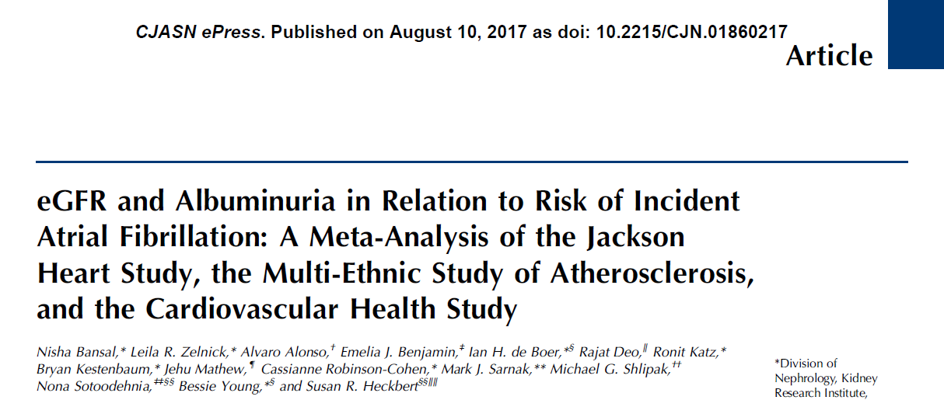
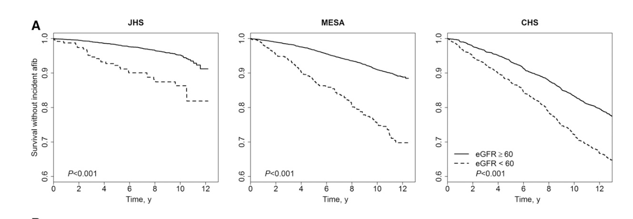
Notes:
There is a bidirectional interaction between AF and chronic kidney disease (CKD): AF facilitates the development or progression of CKD, and the prevalence and incidence of AF increases with decreasing renal function.176–179 Patients with AF and CKD have an increased morbidity and mortality due to their excessive risk for both thromboembolic and severe bleeding events, making risk stratification and treatment challenging.180,181
BACKGROUND AND OBJECTIVES:
The incidence of atrial fibrillation is high in ESRD, but limited data are available on the incidence of atrial fibrillation across a broad range of kidney function. Thus, we examined the association of eGFR and urine albumin-to-creatinine ratio with risk of incident atrial fibrillation.
DESIGN, SETTING, PARTICIPANTS, & MEASUREMENTS:
We meta-analyzed three prospective cohorts: the Jackson Heart Study, the Multi-Ethnic Study of Atherosclerosis, and the Cardiovascular Health Study. Cox regression models were performed examining the association of eGFR and urine albumin-to-creatinine ratio with incident atrial fibrillation adjusting for demographics and comorbidity. In additional analyses, we adjusted for measures of subclinical cardiovascular disease (by electrocardiogram and cardiac imaging) and interim heart failure and myocardial infarction events.
RESULTS:
In the meta-analyzed study population of 16,769 participants without prevalent atrial fibrillation, across categories of decreasing eGFR (eGFR>90 [reference], 60-89, 45-59, 30-44, and <30 ml/min per 1.73 m²), there was a stepwise increase in the adjusted risk of incident atrial fibrillation: hazard ratios (95% confidence intervals) were 1.00, 1.09 (0.97 to 1.24), 1.17 (1.00 to 1.38), 1.59 (1.28 to 1.98), and 2.03 (1.40 to 2.96), respectively. There was a stepwise increase in the adjusted risk of incident atrial fibrillation across categories of increasing urine albumin-to-creatinine ratio (urine albumin-to-creatinine ratio <15 [reference], 15-29, 30-299, and ≥300 mg/g): hazard ratios (95% confidence intervals) were 1.00, 1.04 (0.83 to 1.30), 1.47 (1.20 to 1.79), and 1.76 (1.18 to 2.62), respectively. The associations were consistent after adjustment for subclinical cardiovascular disease measures and interim heart failure and myocardial infarction events.
CONCLUSIONS:
In this meta-analysis of three cohorts, reduced eGFR and elevated urine albumin-to-creatinine ratio were significantly associated with greater risk of incident atrial fibrillation, highlighting the need for further studies to understand mechanisms linking kidney disease with atrial fibrillation.
14

Slide 15
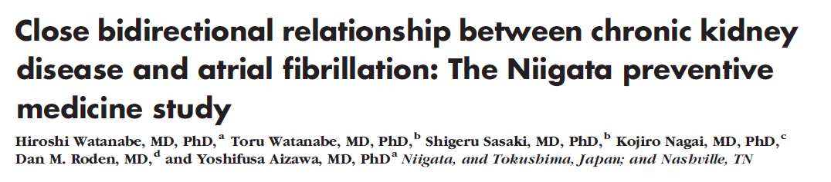
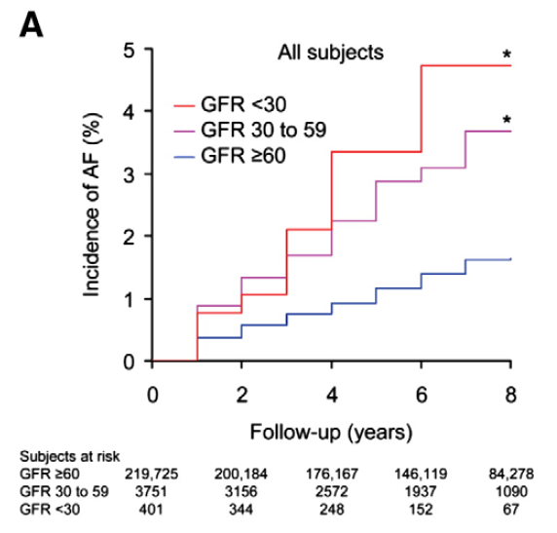
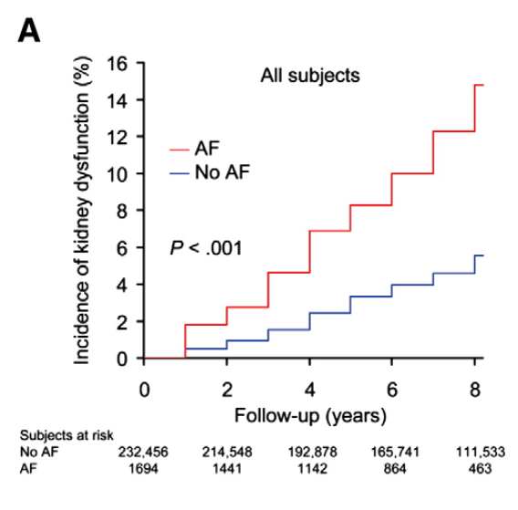
Watanabe H. Am Heart J 2009;158:629-36.
Notes:
BACKGROUND:
Atrial fibrillation (AF) and chronic kidney disease share risk factors and pathophysiologic mechanisms, suggesting that two conditions have close relationships.
METHODS:
This is a prospective community-based observational cohort study including 235,818 subjects based upon a voluntary annual health check-up program in Japan. We studied the association of kidney dysfunction at entry with subsequent new-onset AF and the association of AF at entry with the development of kidney disease.
RESULTS:
During a follow-up of 5.9 +/- 2.4 years, AF developed in 2947 subjects (1.3%). Baseline serum creatinine and estimated glomerular filtration rate (GFR) were associated with risk of subsequent AF. The HRs (95% CI) for AF were 1.32 (1.08-1.62) and 1.57 (0.89-2.77) for GFR 30 to 59 and <30 mL/min per 1.73 m(2), respectively. The effect of kidney disease on risk of new-onset AF remained significant in subjects without treated hypertension or diabetes. During the follow-up, 7791 subjects (3.3%) developed kidney dysfunction (GFR <60 mL/min per 1.73 m(2)), and 11 307 subjects (4.9%) developed proteinuria. Atrial fibrillation at entry was associated with development of kidney dysfunction (HRs [95% CI], 1.77 [1.50-2.10]) and proteinuria (HR [95% CI], 2.20 [1.92-2.52]). The association persisted in subjects without treated hypertension or diabetes.
CONCLUSIONS:
Kidney dysfunction increased the risk of new onset of AF, and AF increased the risk of development of kidney disease. This finding supports the concept that the two conditions share common abnormal molecular signaling pathways contributing to their pathogenesis.
15

Slide 16
Atrial fibrillation and chronic kidney disease
Hindricks G. 2020 ESC guidelines on AF management. Eur Heart J 2020;42:373-498
Notes:
16

Slide 17
Atrial fibrillation and chronic kidney disease
Hindricks G. 2020 ESC guidelines on AF management. Eur Heart J 2020;42:373-498
Notes:
17

Slide 18
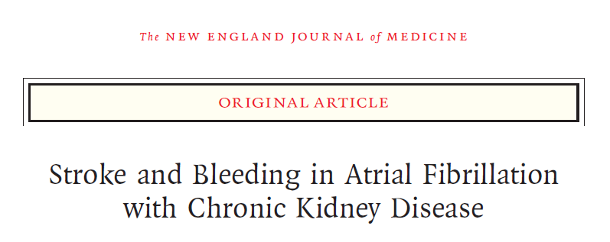
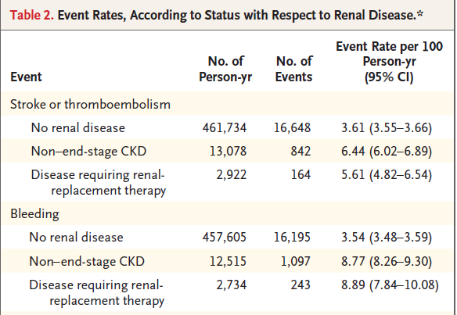
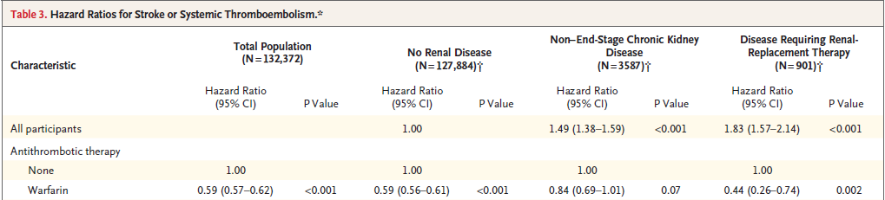
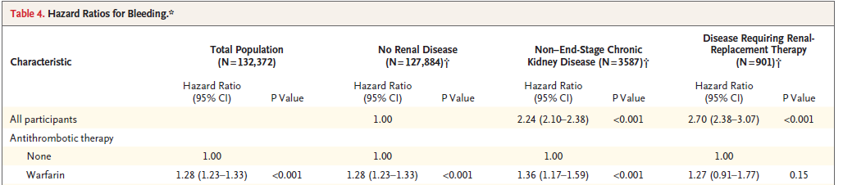
N=132.372 pacientes
Olesen JB. N Engl J Med 2012;367:625-35.
Notes:
BACKGROUND:
Both atrial fibrillation and chronic kidney disease increase the risk of stroke and systemic thromboembolism. However, these risks, and the effects of antithrombotic treatment, have not been thoroughly investigated in patients with both conditions.
METHODS:
Using Danish national registries, we identified all patients discharged from the hospital with a diagnosis of nonvalvular atrial fibrillation between 1997 and 2008. The risk of stroke or systemic thromboembolism and bleeding associated with non-end-stage chronic kidney disease and with end-stage chronic kidney disease (i.e., disease requiring renal-replacement therapy) was estimated with the use of time-dependent Cox regression analyses. In addition, the effects of treatment with warfarin, aspirin, or both in patients with chronic kidney disease were compared with the effects in patients with no renal disease.
RESULTS:
Of 132,372 patients included in the analysis, 3587 (2.7%) had non-end-stage chronic kidney disease and 901 (0.7%) required renal-replacement therapy at the time of inclusion. As compared with patients who did not have renal disease, patients with non-end-stage chronic kidney disease had an increased risk of stroke or systemic thromboembolism (hazard ratio, 1.49; 95% confidence interval [CI], 1.38 to 1.59; P<0.001), as did those requiring renal-replacement therapy (hazard ratio, 1.83; 95% CI, 1.57 to 2.14; P<0.001); this risk was significantly decreased for both groups of patients with warfarin but not with aspirin. The risk of bleeding was also increased among patients who had non-end-stage chronic kidney disease or required renal-replacement therapy and was further increased with warfarin, aspirin, or both.
CONCLUSIONS:
Chronic kidney disease was associated with an increased risk of stroke or systemic thromboembolism and bleeding among patients with atrial fibrillation. Warfarin treatment was associated with a decreased risk of stroke or systemic thromboembolism among patients with chronic kidney disease, whereas warfarin and aspirin were associated with an increased risk of bleeding. (Funded by the Lundbeck Foundation.).
18

Slide 19
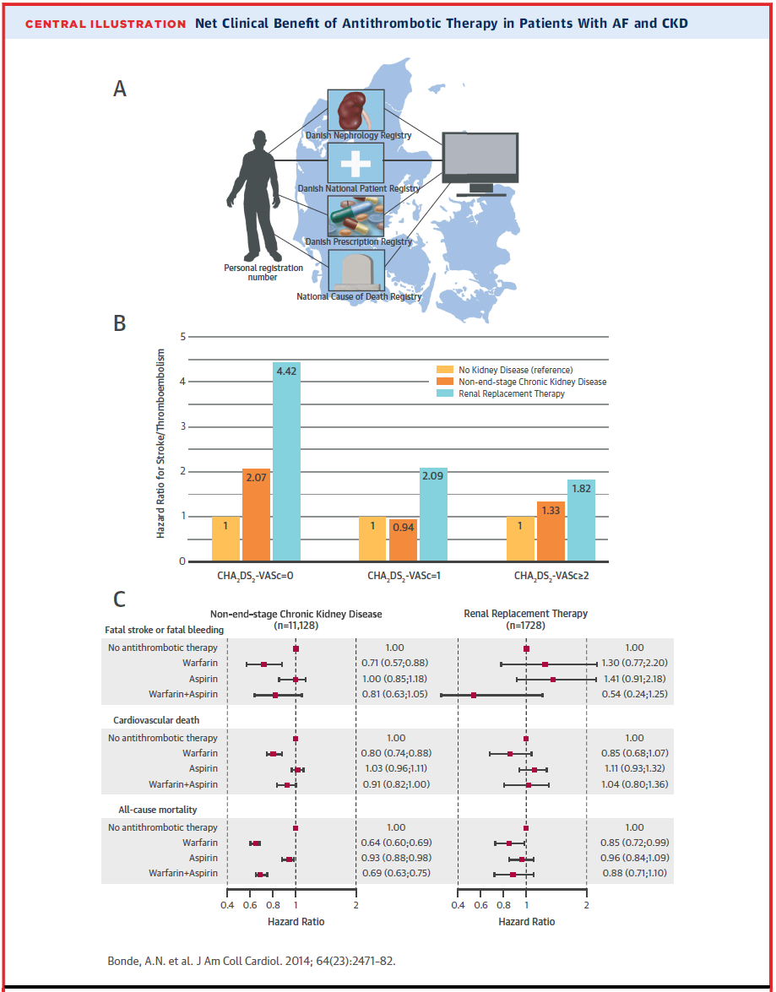
N=154.259 pacientes
Notes:
BACKGROUND:
The balance between stroke reduction and increased bleeding associated with antithrombotic therapy among patients with atrial fibrillation (AF) and chronic kidney disease (CKD) is controversial.
OBJECTIVES:
This study assessed the risk associated with CKD in individual CHA₂DS₂-VASc (Congestive heart failure; Hypertension; Age ≥75 years; Diabetes mellitus; previous Stroke, transient ischemic attack, or thromboembolism; Vascular disease; Age 65 to 74 years; Sex category) strata and the net clinical benefit of warfarin in patients with AF and CKD in a nationwide cohort.
METHODS:
By individual-level linkage of nationwide Danish registries, we identified all patients discharged with nonvalvular AF from 1997 to 2011. The stroke risk associated with non-end-stage CKD and end-stage CKD (e.g., patients on renal replacement therapy [RRT]) was estimated using Cox regression analyses. The net clinical benefit of warfarin was assessed using 4 endpoints: a composite endpoint of death/hospitalization from stroke/bleeding; a composite endpoint of fatal stroke/fatal bleeding; cardiovascular death; and all-cause death.
RESULTS:
From nonvalvular AF patients (n = 154,259), we identified 11,128 patients (7.2%) with non-end-stage CKD and 1,728 (1.1%) receiving RRT. In all CHA₂DS₂-VASc risk groups, RRT was independently associated with a higher risk of stroke/thromboembolism, from a 5.5-fold higher risk in patients with CHA₂DS₂-VASc score = 0 to a 1.6-fold higher risk in patients with CHA₂DS₂-VASc score ≥2. In patients receiving RRT with CHA₂DS₂-VASc score ≥2, warfarin was associated with lower risk of all-cause death (hazard ratio [HR]: 0.85, 95% confidence interval [CI]: 0.72 to 0.99). In non-end-stage CKD patients with CHA₂DS₂-VASc score ≥2, warfarin was associated with a lower risk of a composite outcome of fatal stroke/fatal bleeding (HR: 0.71, 95% CI: 0.57 to 0.88), a lower risk of cardiovascular death (HR: 0.80, 95% CI: 0.74 to 0.88), and a lower risk of all-cause death (HR: 0.64, 95% CI: 0.60 to 0.69).
CONCLUSIONS:
CKD is associated with a higher risk of stroke/thromboembolism across stroke risk strata in AF patients. High-risk CKD patients (CHA₂DS₂-VASc ≥2) with AF benefit from warfarin treatment for stroke prevention.
19

Slide 20
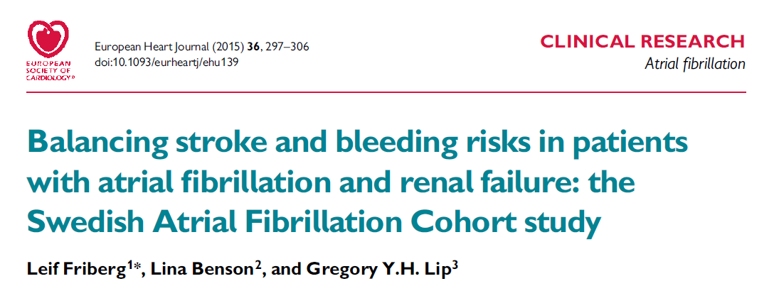
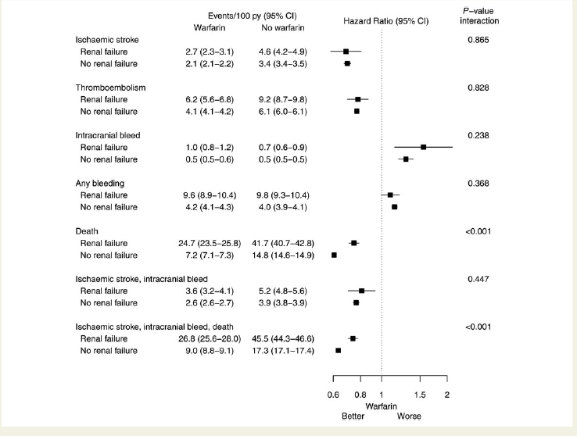
N=307.351 pacientes
Notes:
BACKGROUND:
Patients who have both atrial fibrillation (AF) and renal failure have an increased risk of thrombo-embolism. Renal failure is also a risk factor for bleeding, which makes decisions regarding thromboprophylaxis complicated. Our aim was to determine risks for ischaemic stroke and bleeding in patients with AF and renal failure in relation to anticoagulant strategies.
METHODS AND RESULTS:
This is retrospective non-randomized study of Swedish health registers comprising 307 351 patients with AF, of whom 13 435 had a previous diagnosis of renal failure. Ischaemic stroke occurred more often in AF patients with renal failure (annual rate, 3.9% vs. no renal failure, 2.9%), but this was related to concomitant comorbidities [adjusted hazard ratio (HR) 1.02, 95% confidence interval (CI) 0.95-1.10]. Adding renal failure to the established stroke risk stratification schemes (CHADS2 and CHA2DS2-VASc) did not improve their predictive value. Renal failure was an independent risk factor for intracranial bleeding [adjusted HR: 1.27 (1.09-1.49)]. Most patients with renal failure benefited from warfarin treatment, despite their high bleeding risk. The incidence of the combined endpoint ischaemic or haemorrhagic stroke or death was lower among those who used warfarin than among those who did not use warfarin (adjusted HR: 0.76, CI 0.72-0.80).
CONCLUSIONS:
Patients with both AF and renal failure will probably benefit most from having the same treatment as is recommended for other patients with AF, without setting a higher or lower threshold for treatment. Adding additional points for renal failure to the CHADS2 and CHA2DS2-VASc scores did not improve their predictive value.
20

Slide 21
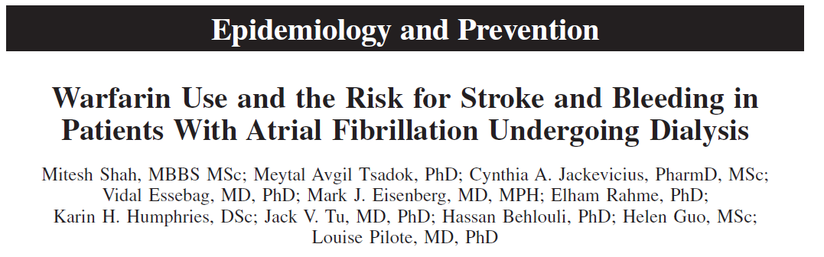
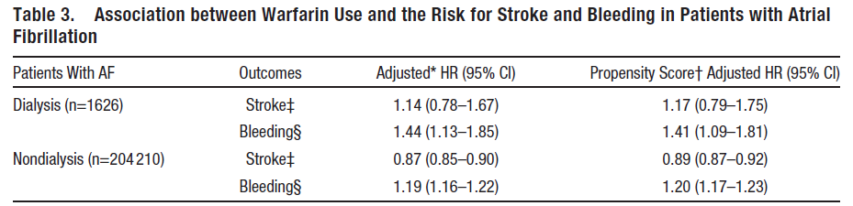
Shah M. Circulation 2014;129:1196-203.
Notes:
BACKGROUND:
Current observational studies on warfarin use and the risk for stroke and bleeding in patients with atrial fibrillation (AF) undergoing dialysis found conflicting results.
METHODS AND RESULTS:
We conducted a population-based retrospective cohort study of patients aged ≥65 years admitted to a hospital with a primary or secondary diagnosis of AF, in Quebec and Ontario, Canada from 1998 to 2007. The AF cohort was grouped into dialysis (hemodialysis and peritoneal dialysis) and nondialysis patients and into warfarin and no-warfarin users according to the first prescription filled for warfarin within 30 days after AF hospital discharge. We determined the association between warfarin use and the risk for stroke and bleeding in dialysis and nondialysis patients. The cohort comprised 1626 dialysis patients and 204 210 nondialysis patients. Among dialysis patients, 46% (756/1626) patients were prescribed warfarin. Among dialysis patients, warfarin users had more congestive heart failure and diabetes mellitus, but fewer prior bleeding events in comparison with the no-warfarin users. Among dialysis patients, warfarin use, in comparison with no-warfarin use, was not associated with a lower risk for stroke (adjusted hazard ratio, 1.14; 95% confidence interval, 0.78-1.67) but was associated with a 44% higher risk for bleeding (adjusted hazard ratio, 1.44; 95% confidence interval, 1.13-1.85) after adjusting for potential confounders. Propensity score-adjusted analyses yielded similar results.
CONCLUSIONS:
Our results suggest that warfarin use is not beneficial in reducing stroke risk, but it is associated with a higher bleeding risk in patients with AF undergoing dialysis.
21

Slide 22
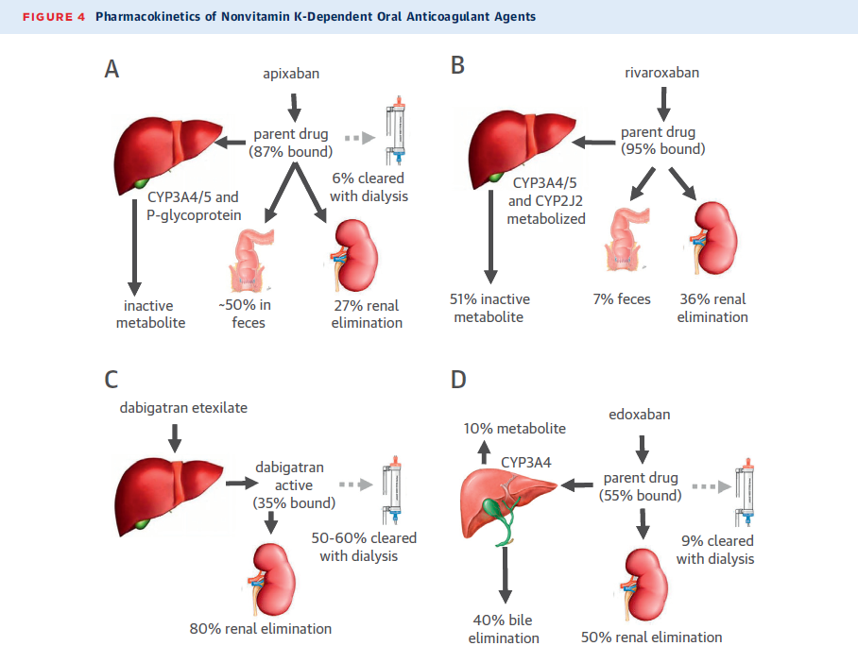
Chan KE. J Am Coll Cardiol 2016;67:2888-99

Slide 23
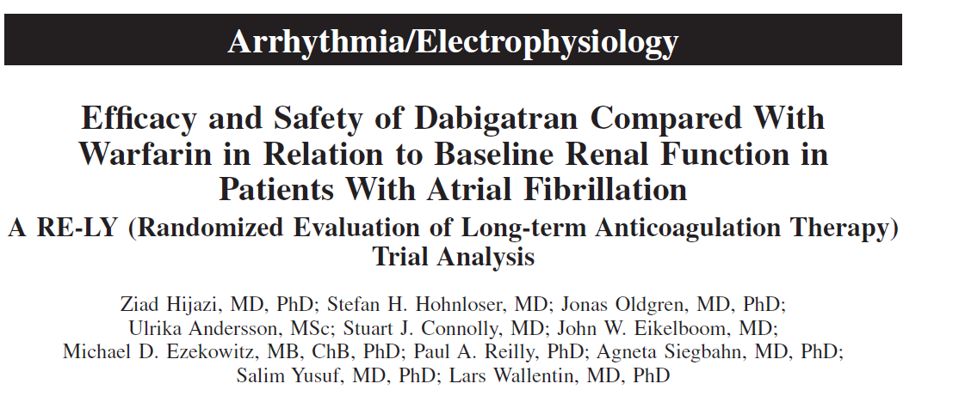
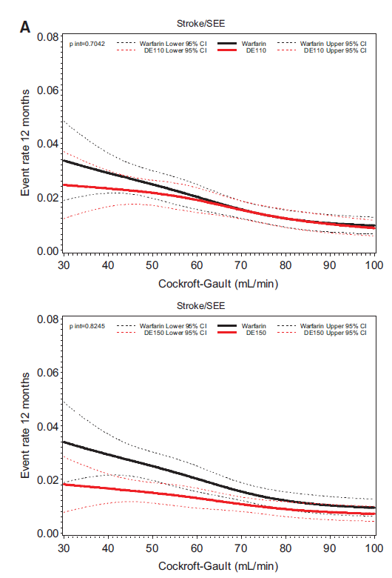
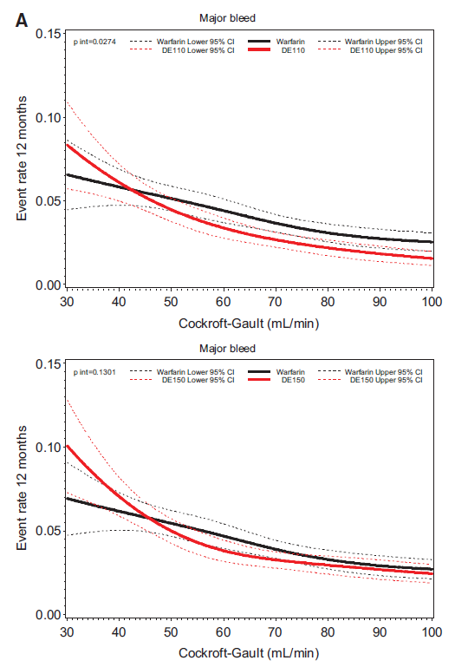
Hijazi Z. Circulation 2014;129:961-70.
Notes:
BACKGROUND:
Renal impairment increases the risk of stroke and bleeding in patients with atrial fibrillation. In the Randomized Evaluation of Long-Term Anticoagulant Therapy (RELY) trial, dabigatran, with ≈80% renal elimination, displayed superiority over warfarin for prevention of stroke and systemic embolism in the 150-mg dose and significantly less major bleeding in the 110-mg dose in 18 113 patients with nonvalvular atrial fibrillation. This prespecified study investigated these outcomes in relation to renal function.
METHODS AND RESULTS:
Glomerular filtration rate was estimated with the Cockcroft-Gault, Chronic Kidney Disease Epidemiology Collaboration (CKD-EPI), and Modification of Diet in Renal Disease (MDRD) equations in all randomized patients with available creatinine at baseline (n=17 951), and cystatin C-based glomerular filtration rate was estimated in a subpopulation with measurements available (n=6190). A glomerular filtration rate ≥80, 50 to <80, and <50 mL/min was estimated in 32.6%, 47.6%, and 19.8% and in 21.6%, 59.6%, and 18.8% of patients based on Cockcroft-Gault and CKD-EPI, respectively. Rates of stroke or systemic embolism, major bleeding, and all-cause mortality increased as renal function decreased. The rates of stroke or systemic embolism were lower with dabigatran 150 mg and similar with 110 mg twice daily compared with warfarin, without significant heterogeneity in subgroups defined by renal function (interaction P>0.1 for all). For the outcome of major bleeding, there were significant interactions between treatment and renal function according to CKD-EPI and MDRD equations, respectively (P<0.05). The relative reduction in major bleeding with either dabigatran dose compared with warfarin was greater in patients with glomerular filtration rate ≥80 mL/min.
CONCLUSIONS:
The efficacy of both dosages of dabigatran was consistent with the overall trial irrespective of renal function. However, with the CKD-EPI and MDRD equations, both dabigatran dosages displayed significantly lower rates of major bleeding in patients with glomerular filtration rate ≥80 mL/min.
23

Slide 24
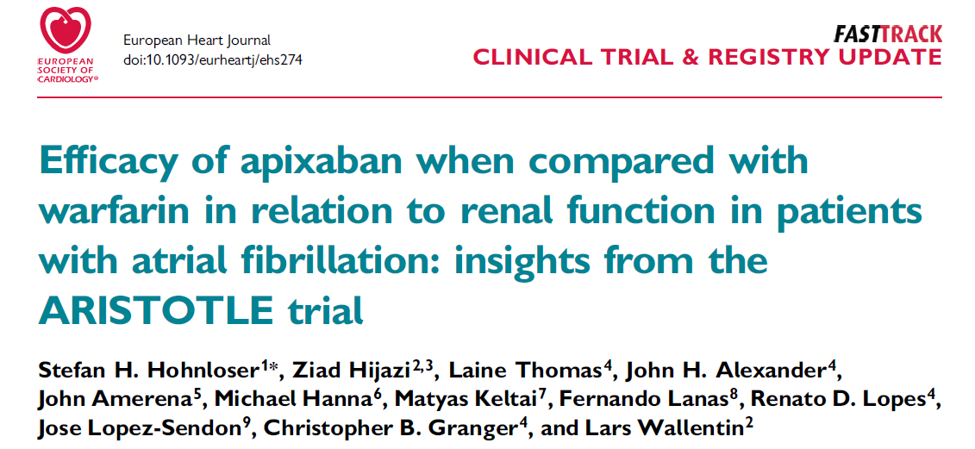
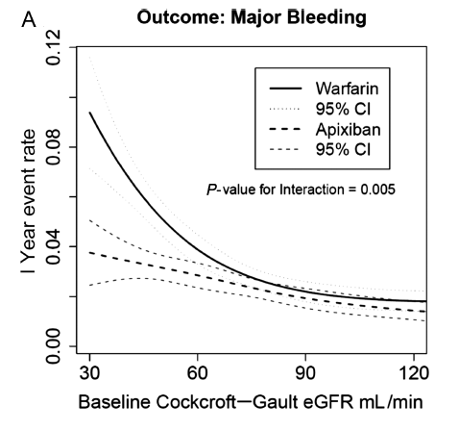

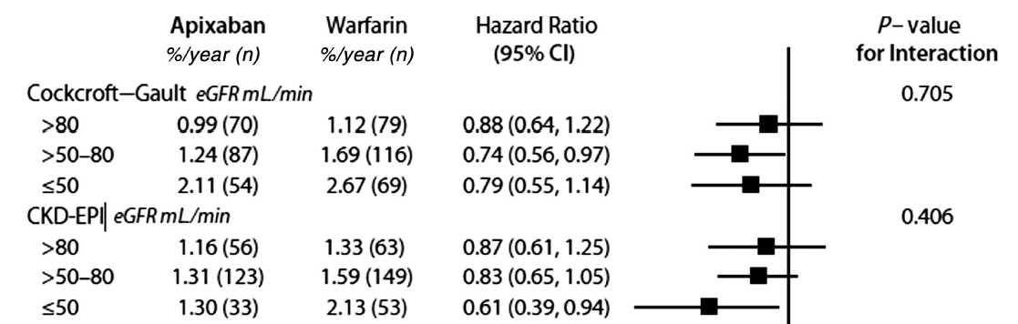
Hohnloser SH. Eur Heart J 2012;33:2821-30.
Notes:
AIMS:
Atrial fibrillation (AF) is common among patients with impaired renal function. Apixaban, a novel oral anticoagulant with partial renal excretion, was compared with warfarin and reduced the rate stroke, death and bleeding in the ARISTOTLE trial. We evaluated these outcomes in relation to renal function.
METHODS AND RESULTS:
Baseline glomerular filtration rate (GFR) was estimated using the Cockcroft-Gault and Chronic Kidney Disease Epidemiology Collaboration (CKD-EPI) equations as well as cystatin C measurements. According to baseline Cockcroft-Gault, there were 7518 patients (42%) with an estimated GFR (eGFR) of >80 mL/min, 7587 (42%) between >50 and 80 mL/min, and 3017 (15%) with an eGFR of ≤50 mL/min. The rate of cardiovascular events and bleeding was higher at impaired renal function (≤80 mL/min). Apixaban was more effective than warfarin in preventing stroke or systemic embolism and reducing mortality irrespective of renal function. These results were consistent, regardless of methods for GFR estimation. Apixaban was associated with less major bleeding events across all ranges of eGFRs. The relative risk reduction in major bleeding was greater in patients with an eGFR of ≤50 mL/min using Cockcroft-Gault {hazard ratio (HR) 0.50 [95% confidence interval (CI) 0.38-0.66], interaction P = 0.005} or CKD-EPI equations [HR 0.48 (95% CI 0.37-0.64), interaction P = 0.003].
CONCLUSION:
In patients with AF, renal impairment was associated with increased risk of cardiovascular events and bleeding. When compared with warfarin, apixaban treatment reduced the rate of stroke, death, and major bleeding, regardless of renal function. Patients with impaired renal function seemed to have the greatest reduction in major bleeding with apixaban.
24

Slide 25
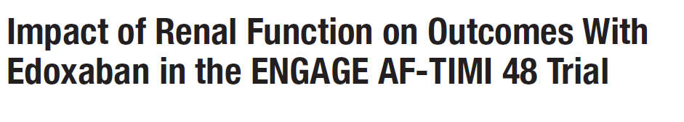
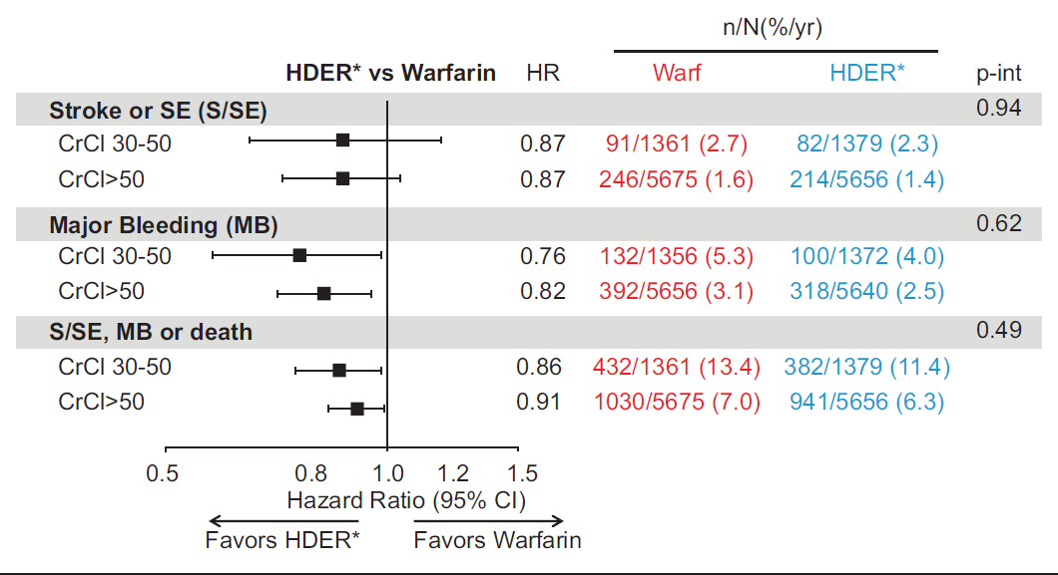
Bohula EA. Circulation. 2016 Jul 5;134(1):24-36.
Notes:
On the other side of the spectrum, a possibly decreased efficacy of edoxaban 60 mg OD compared with warfarin was observed in patients with a CrCl of >95 mL/min.31 Interestingly, as a result of these findings, further post hoc analyses revealed a similar effect also for Rivaroxaban188 and Apixaban.189 In 2015 the FDA issued a warning about the use of edoxaban in individuals with such a highnormal CrCl, and recommended the use of other oral anticoagulants
in these patients. Also the EMA advised that ‘edoxaban should only be used in patients with high CrCl after a careful evaluation of the individual thromboembolic and bleeding risk’. A post hoc analysis of the ENGAGE AF data showed that despite the trend towards a decrease in relative efficacy of edoxaban 60mg OD in the upper range of CrCl in an exploratory (not pre-defined) subgroup analysis, the safety and net clinical benefit of edoxaban compared with warfarin were consistent across the spectrum of renal function.190
25

Slide 26
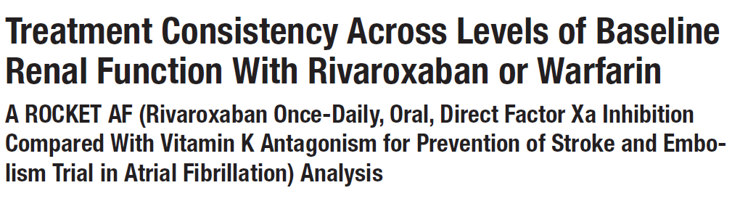
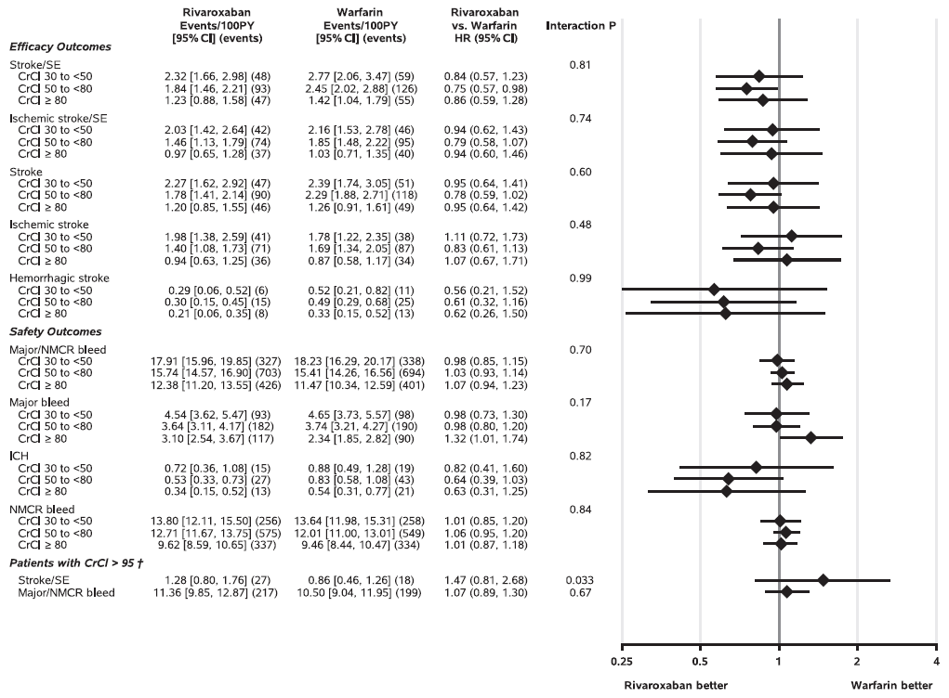
Lindner SM. Circulation 2017;135:1001-1003.
Notes:
26

Slide 27
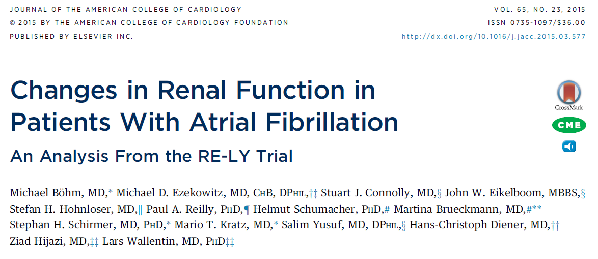
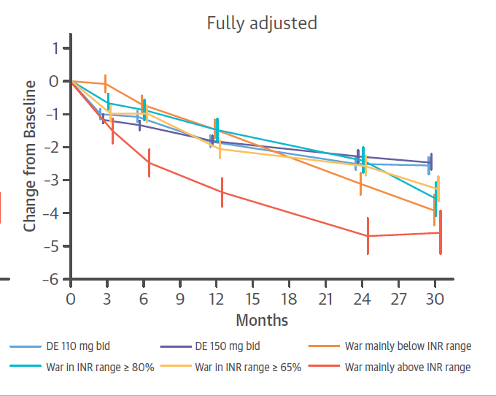
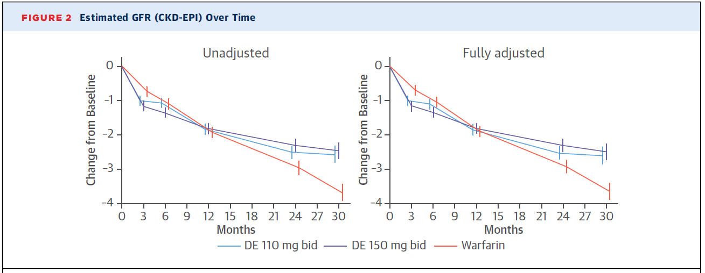
Böhm M. JACC 2015; 65:2481–93,
Notes:
A post hoc analysis of the RE-LY trial data showed a significantly faster rate of decline in renal function during the trial in patients on warfarin (especially at lower TTRs) compared with those on dabigatran200 suggesting that it may delay the decline in renal function compared with warfarin. Moreover, it has been suggested that warfarin use may be associated with increased vascular calcification and/or the development of acute warfarin-related nephropathy with or without clinically overt haematuria.201
BACKGROUND:
Vitamin K-dependent factors protect against vascular and renovascular calcification, and vitamin K antagonists may be associated with a decreased glomerular filtration rate (GFR).
OBJECTIVES:
This study analyzed changes in GFR during long-term treatment with warfarin or dabigatran etexilate (DE) in patients enrolled in the RE-LY (Randomized Evaluation of Long Term Anticoagulation Therapy) trial.
METHODS:
Of the 18,113 patients in the RE-LY study randomized to receive DE (110 mg or 150 mg twice daily) or warfarin, 16,490 patients with atrial fibrillation had creatinine values measured at baseline and at least 1 follow-up visit. Changes in GFR for up to 30 months were evaluated.
RESULTS:
GFR declined in all treatment groups. After an average of 30 months, the mean ± SE decline in GFR was significantly greater with warfarin (-3.68 ± 0.24 ml/min) compared with DE 110 mg (-2.57 ± 0.24 ml/min; p = 0.0009 vs. warfarin) and DE 150 mg (-2.46 ± 0.23 ml/min; p = 0.0002 vs. warfarin). A decrease in GFR >25% was less likely with DE 110 mg (hazard ratio: 0.81 [95% confidence interval: 0.69 to 0.96]; p = 0.017) or DE 150 mg (hazard ratio: 0.79 [95% confidence interval: 0.68 to 0.93]; p = 0.0056) than with warfarin in the observation period >18 months. Patients with poor international normalized ratio control (i.e., time in therapeutic range <65%) exhibited a faster decline in GFR. A more pronounced decline in GFR was associated with previous warfarin use and with the presence of diabetes.
CONCLUSIONS:
Patients with atrial fibrillation receiving oral anticoagulation exhibited a decline in renal function that was greater in those taking warfarin versus DE, and it was amplified by diabetes and previous vitamin K antagonist use.
27

Slide 28
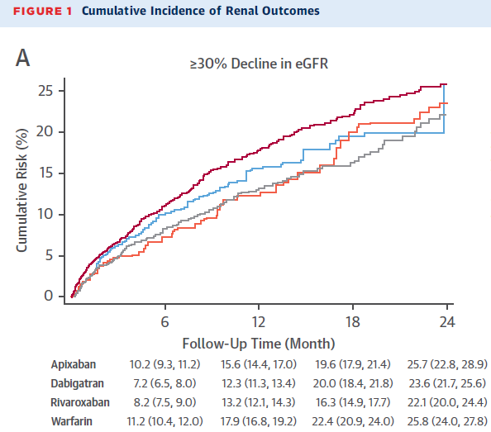
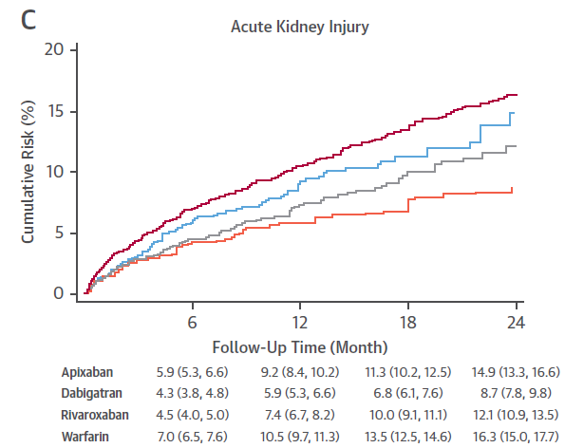
Menor deterioro de la función renal ACODs vs warfarina en RWE (registro USA)
En un estudio reciente en RWE con 9,769 pacientes se ha evidenciado menor deterioro de la función renal para los ACODs vs warfarina
Estos resultados confirman lo observado en los respectivos estudios de los ACOD sobre deterioro renal
Yao et al. J Am Coll Cardiol 2017;70:2621–32

Slide 29
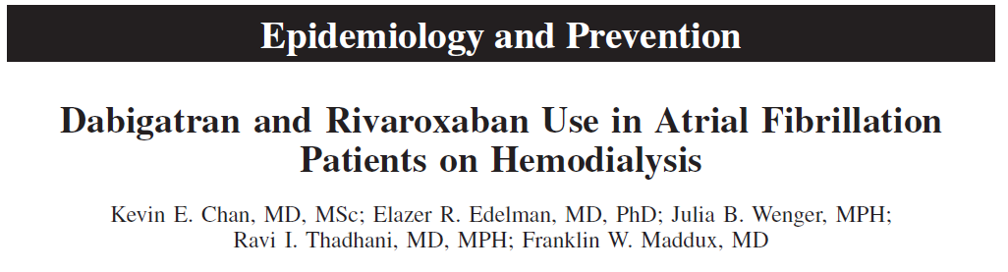
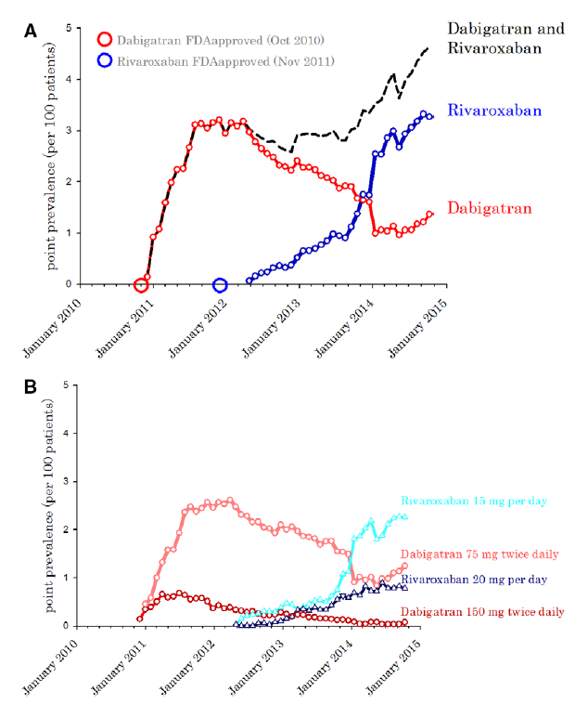
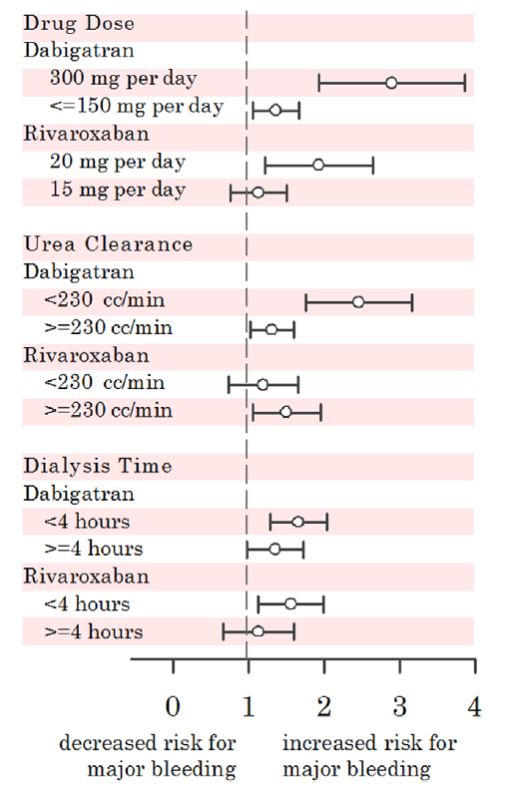
Chan KE. Circulation. 2015 Mar 17;131(11):972-9.
Notes:
BACKGROUND:
Dabigatran and rivaroxaban are new oral anticoagulants that are eliminated through the kidneys. Their use in dialysis patients is discouraged because these drugs can bioaccumulate to precipitate inadvertent bleeding. We wanted to determine whether prescription of dabigatran or rivaroxaban was occurring in the dialysis population and whether these practices were safe.
METHODS AND RESULTS:
Prevalence plots were used to describe the point prevalence (monthly) of dabigatran and rivaroxaban use among 29977 hemodialysis patients with atrial fibrillation. Poisson regression compared the rate of bleeding, stroke, and arterial embolism in patients who started dabigatran, rivaroxaban, or warfarin. The first record of dabigatran prescription among hemodialysis patients occurred 45 days after the drug became available in the United States. Since then, dabigatran and rivaroxaban use in the atrial fibrillation-end-stage renal disease population has steadily risen where 5.9% of anticoagulated dialysis patients are started on dabigatrian or rivaroxaban. In covariate adjusted Poisson regression, dabigatran (rate ratio, 1.48; 95% confidence interval, 1.21-1.81; P=0.0001) and rivaroxaban (rate ratio, 1.38; 95% confidence interval, 1.03-1.83; P=0.04) associated with a higher risk of hospitalization or death from bleeding when compared with warfarin. The risk of hemorrhagic death was even larger with dabigatran (rate ratio, 1.78; 95% confidence interval, 1.18-2.68; P=0.006) and rivaroxaban (rate ratio, 1.71; 95% confidence interval, 0.94-3.12; P=0.07) relative to warfarin. There were too few events in the study to detect meaningful differences in stroke and arterial embolism between the drug groups.
CONCLUSIONS:
More dialysis patients are being started on dabigatran and rivaroxaban, even when their use is contraindicated and there are no studies to support that the benefits outweigh the risks of these drugs in end-stage renal disease.
29

Slide 30
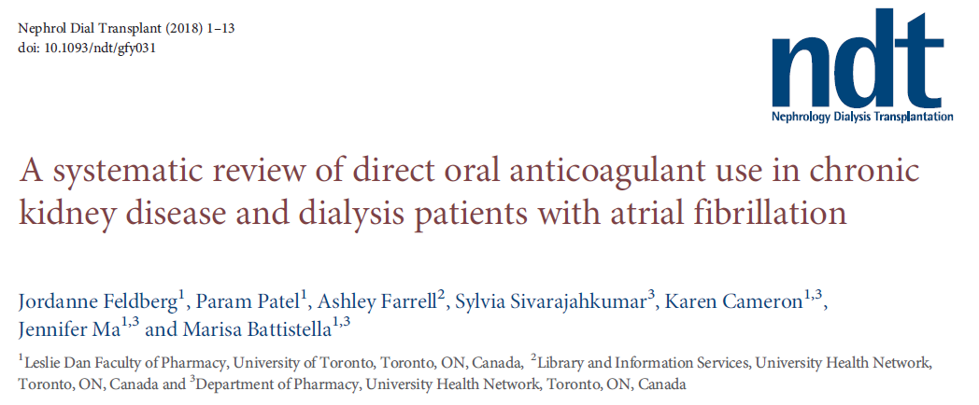
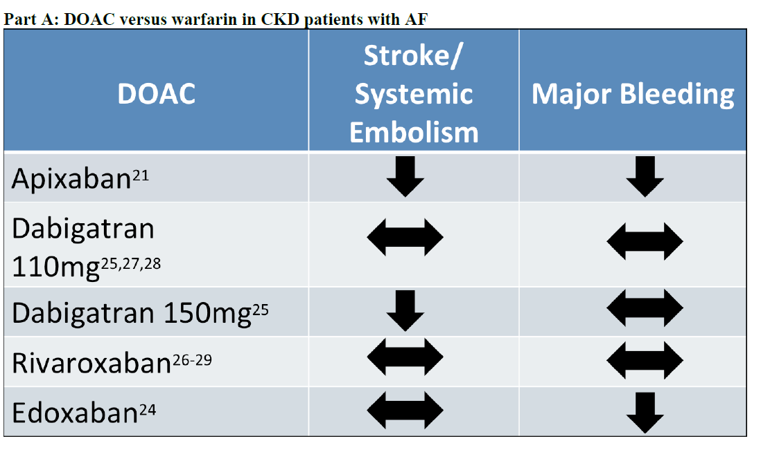
Notes:
BACKGROUND:
There is a lack of clear benefit and a potential risk of bleeding with direct oral anticoagulant (DOAC) use in chronic kidney disease (CKD) and dialysis patients with atrial fibrillation. The objective of this study was to evaluate how treatment with DOACs affects stroke and bleeding outcomes compared with warfarin or aspirin.
METHODS:
We conducted a systematic review of randomized controlled trials, cohort studies and case series, and searched electronic databases from 1946 to 2017. Studies evaluating stroke and bleeding outcomes with DOAC use in CKD and dialysis patients were included.
RESULTS:
From 8008 studies, 10 met the inclusion criteria. For moderate CKD patients (estimated glomerular filtration rate <60 mL/min/1.73 m2), there was no difference in stroke outcomes between dabigatran 110 mg [hazard ratio (HR) 0.78, 95% confidence interval (95% CI) 0.51-1.21], rivaroxaban (HR 0.82-0.84, 95% CI 0.25-2.69) and edoxaban (HR 0.87, 95% CI 0.65-1.18) versus warfarin. Dabigatran (150 mg twice daily) and apixaban reduced risk of stroke or systemic embolism significantly more than warfarin for moderate CKD patients (HR 0.55, 95% CI 0.34-0.89 and HR 0.61, 95% CI 0.39-0.94, respectively). Edoxaban and apixaban were associated with reduced major bleeding events (HR 0.50-0.76) compared with warfarin. Rivaroxaban and dabigatran 110 mg and 150 mg showed no significant difference in major bleeding versus warfarin. In hemodialysis (HD) patients, there was no difference in stroke outcomes between apixaban, dabigatran [relative risk (RR) 1.71, 95% CI 0.97-2.99] or rivaroxaban (RR 1.8, 95% CI 0.89-3.64) versus warfarin. In HD patients, rivaroxaban and dabigatran were associated with an increased major bleeding risk (RR 1.45-1.76), whereas there was no major bleeding difference with apixaban compared to warfarin.
LIMITATIONS:
The heterogeneity of major bleeding and stroke definitions of the 10 included studies.
CONCLUSIONS:
Clinicians should continue to weigh the risk of stroke versus bleeding before prescribing DOACs in the CKD and dialysis population
30

Slide 31
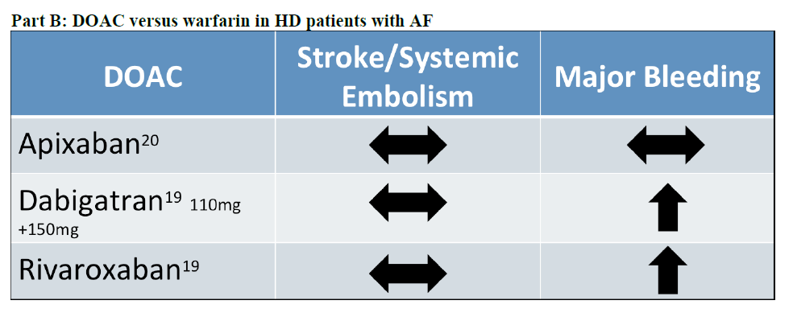
Notes:
BACKGROUND:
There is a lack of clear benefit and a potential risk of bleeding with direct oral anticoagulant (DOAC) use in chronic kidney disease (CKD) and dialysis patients with atrial fibrillation. The objective of this study was to evaluate how treatment with DOACs affects stroke and bleeding outcomes compared with warfarin or aspirin.
METHODS:
We conducted a systematic review of randomized controlled trials, cohort studies and case series, and searched electronic databases from 1946 to 2017. Studies evaluating stroke and bleeding outcomes with DOAC use in CKD and dialysis patients were included.
RESULTS:
From 8008 studies, 10 met the inclusion criteria. For moderate CKD patients (estimated glomerular filtration rate <60 mL/min/1.73 m2), there was no difference in stroke outcomes between dabigatran 110 mg [hazard ratio (HR) 0.78, 95% confidence interval (95% CI) 0.51-1.21], rivaroxaban (HR 0.82-0.84, 95% CI 0.25-2.69) and edoxaban (HR 0.87, 95% CI 0.65-1.18) versus warfarin. Dabigatran (150 mg twice daily) and apixaban reduced risk of stroke or systemic embolism significantly more than warfarin for moderate CKD patients (HR 0.55, 95% CI 0.34-0.89 and HR 0.61, 95% CI 0.39-0.94, respectively). Edoxaban and apixaban were associated with reduced major bleeding events (HR 0.50-0.76) compared with warfarin. Rivaroxaban and dabigatran 110 mg and 150 mg showed no significant difference in major bleeding versus warfarin. In hemodialysis (HD) patients, there was no difference in stroke outcomes between apixaban, dabigatran [relative risk (RR) 1.71, 95% CI 0.97-2.99] or rivaroxaban (RR 1.8, 95% CI 0.89-3.64) versus warfarin. In HD patients, rivaroxaban and dabigatran were associated with an increased major bleeding risk (RR 1.45-1.76), whereas there was no major bleeding difference with apixaban compared to warfarin.
LIMITATIONS:
The heterogeneity of major bleeding and stroke definitions of the 10 included studies.
CONCLUSIONS:
Clinicians should continue to weigh the risk of stroke versus bleeding before prescribing DOACs in the CKD and dialysis population
31

Slide 32
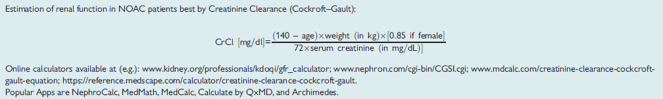
Aclaramiento renal ACOD
Steffel J. Eur Heart J 2018;39:1330-1393
www.senefro.org
Steffel J. Eur Heart J 2018;39:1330-1393
Notes:
Clinical decisions on how to treat an AF patient with CKD who needs OAC requires the assessment of renal function. Basic information on the diagnosis/staging of CKD and assessment of renal function is provided in Table 7. Several equations are available to gauge a patient’s renal function, all with inherent strengths and limitations. The CKD-EPI equation estimating the glomerular filtration rate is recommended by the National Kidney Foundation because it has been shown to be reliable across the range of CKD stages.187 However, in the context of NOAC treatment, renal function should preferably be estimated by calculating the CrCl using the Cockcroft–Gault method, which was used in most NOAC trials and therefore also in this Practical Guide. Importantly, CKD can only be diagnosed and assessed in stable situations and must not be confused with acute renal failure. In the latter case, serum creatinine levels and calculated CrCl may indicate mildly reduced (or even normal) renal function when in reality it is severely impaired.

Slide 33
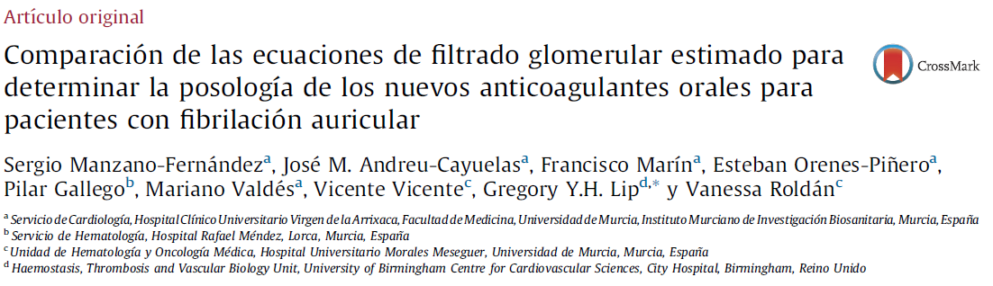
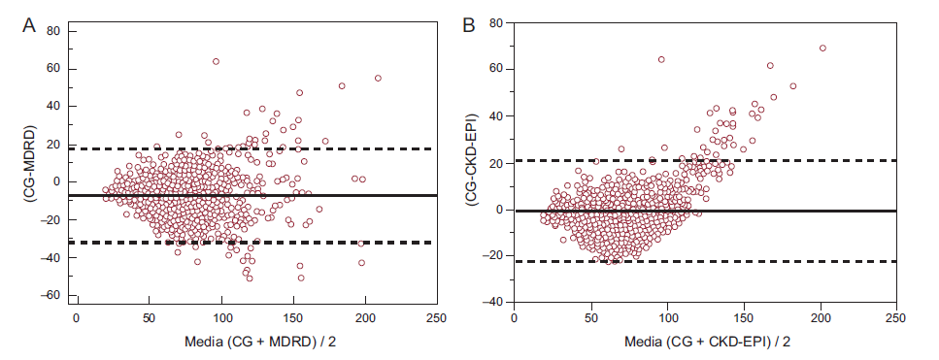
Manzano Fernández S. Rev Esp Cardiol. 2015;68(6):497–504
Notes:
Introducción y objetivosLos nuevos anticoagulantes orales requieren ajuste de la posología según la función renal. El objetivo de este estudio es determinar la discrepancia existente entre la hipotética posología recomendada de estos fármacos empleando diferentes ecuaciones de filtrado glomerular estimado en pacientes con fibrilación auricular.
MétodosAnálisis transversal de 910 pacientes con fibrilación auricular e indicación de anticoagulación oral. Se estimó el filtrado glomerular con las ecuaciones de Cockcroft-Gault, Modification of Diet in Renal Disease y Chronic Kidney Disease Epidemiology Collaboration. Para dabigatrán, rivaroxabán y apixabán, se identificaron discrepancias de la dosis cuando no coincidían con las dosis recomendadas según se usara una u otra ecuación.
ResultadosEn el conjunto de la población, respecto a la ecuación de Cockcroft-Gault, la discrepancia de la posología de dabigatrán fue del 11,4% con la ecuación Modification of Diet in Renal Disease y del 10 con la Chronic Kidney Disease Epidemiology Collaboration; las discrepancias de la posología de rivaroxabán fueron del 10% y el 8,5% respectivamente. La menor discrepancia se observó con apixabán: el 1,4% con la primera y el 1,5% con la segunda. En los pacientes con un valor según la ecuación de Cockcroft-Gault < 60 ml/min o en los pacientes ancianos, las discrepancias en las posologías de dabigatrán y rivaroxabán fueron superiores, entre el 13,2 y el 30,4%. La discrepancia en cuanto a la posología de apixabán se mantuvo en un valor < 5% en estos pacientes.
ConclusionesLa discrepancia en las posologías de los nuevos anticoagulantes orales empleando ecuaciones distintas es frecuente, sobre todo en los pacientes ancianos con deterioro de la función renal. Esta discrepancia fue mayor para las posologías de dabigatrán y rivaroxabán que para la de apixabán. Se necesitan nuevos estudios para esclarecer la importancia clínica de estas discrepancias y determinar la posología óptima de los anticoagulantes según la ecuación que se use para estimar la función renal.
33

Slide 34
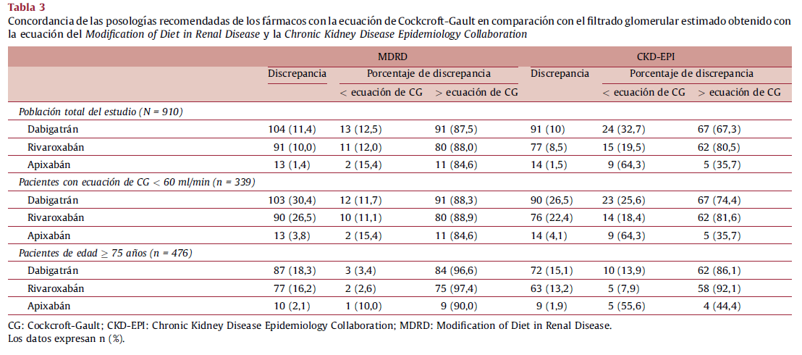
“No disponemos de estudios head-to-head, por lo que no se deben hacer comparaciones directas entre los distintos fármacos”
Manzano Fernández S. Rev Esp Cardiol. 2015;68(6):497–504
Notes:
Introducción y objetivosLos nuevos anticoagulantes orales requieren ajuste de la posología según la función renal. El objetivo de este estudio es determinar la discrepancia existente entre la hipotética posología recomendada de estos fármacos empleando diferentes ecuaciones de filtrado glomerular estimado en pacientes con fibrilación auricular.
MétodosAnálisis transversal de 910 pacientes con fibrilación auricular e indicación de anticoagulación oral. Se estimó el filtrado glomerular con las ecuaciones de Cockcroft-Gault, Modification of Diet in Renal Disease y Chronic Kidney Disease Epidemiology Collaboration. Para dabigatrán, rivaroxabán y apixabán, se identificaron discrepancias de la dosis cuando no coincidían con las dosis recomendadas según se usara una u otra ecuación.
ResultadosEn el conjunto de la población, respecto a la ecuación de Cockcroft-Gault, la discrepancia de la posología de dabigatrán fue del 11,4% con la ecuación Modification of Diet in Renal Disease y del 10 con la Chronic Kidney Disease Epidemiology Collaboration; las discrepancias de la posología de rivaroxabán fueron del 10% y el 8,5% respectivamente. La menor discrepancia se observó con apixabán: el 1,4% con la primera y el 1,5% con la segunda. En los pacientes con un valor según la ecuación de Cockcroft-Gault < 60 ml/min o en los pacientes ancianos, las discrepancias en las posologías de dabigatrán y rivaroxabán fueron superiores, entre el 13,2 y el 30,4%. La discrepancia en cuanto a la posología de apixabán se mantuvo en un valor < 5% en estos pacientes.
ConclusionesLa discrepancia en las posologías de los nuevos anticoagulantes orales empleando ecuaciones distintas es frecuente, sobre todo en los pacientes ancianos con deterioro de la función renal. Esta discrepancia fue mayor para las posologías de dabigatrán y rivaroxabán que para la de apixabán. Se necesitan nuevos estudios para esclarecer la importancia clínica de estas discrepancias y determinar la posología óptima de los anticoagulantes según la ecuación que se use para estimar la función renal.
34

Slide 35
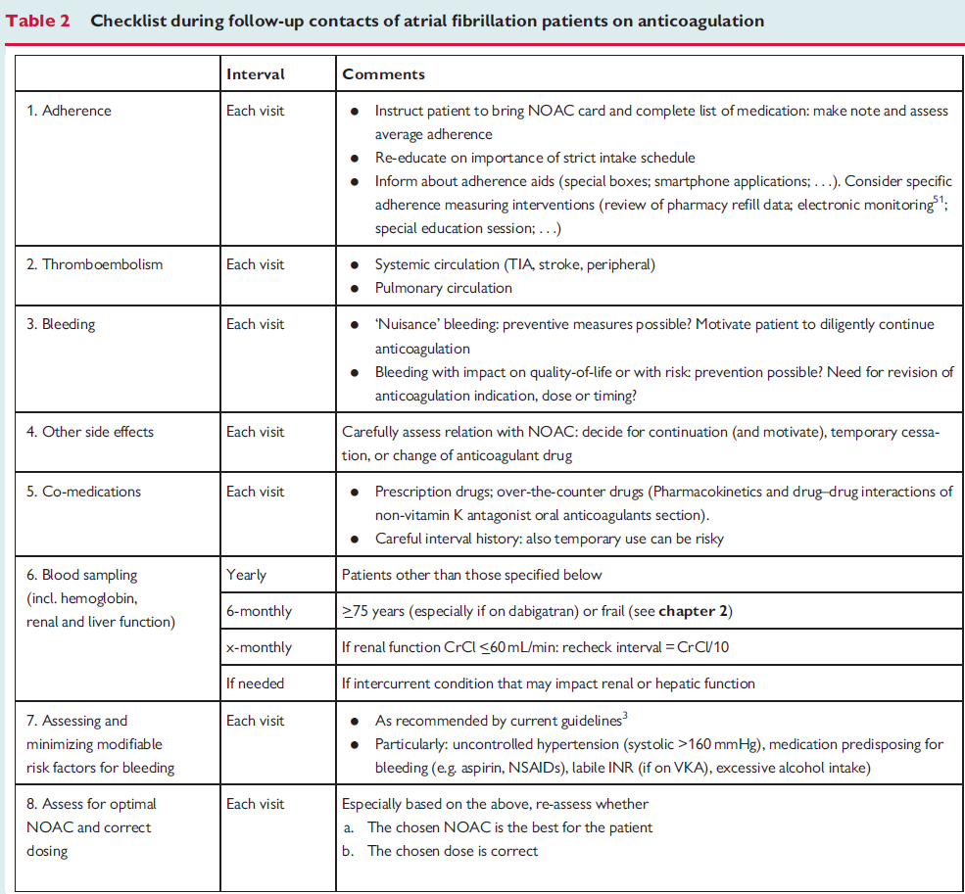
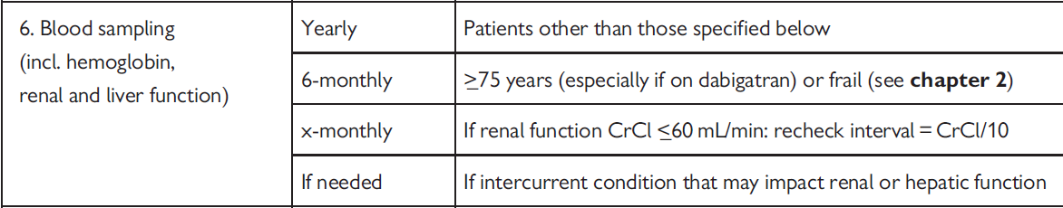
Steffel J. Eur Heart J 2018;39:1330-1393
Notes:
In patients on NOACs, renal function needs to be monitored diligently, at least yearly, to detect changes in renal function and adapt the dose accordingly. If renal function is impaired (i.e. CrCl <_60mL/min), a more frequent evaluation is recommended (e.g. by dividing CrCl by 10 to obtain theminimum frequency of renal function testing
in months; Table 2). In patients with additional risk factors (e.g. older age, frail, multiple co-morbidities etc.), it may be evaluated even more frequently, especially if on dabigatran. Intercurrent acute illness (like infections, acute heart failure, etc.) may transiently affect renal function and should also trigger re-evaluation; importantly, patients need
to be alerted that in such situations they should seek contact with their healthcare provider. This guidance is also presented in the updatedNOAC Card.
35

Slide 36
Fibrilación auricular e insuficiencia renal: ¿anticoagular o no anticoagular?
La insuficiencia renal es una comorbilidad frecuente en pacientes con FA, que aumenta el riesgo trombótico y hemorrágico.
En insuficiencia renal moderada, la anticoagulación disminuye eventos embólicos y tiene un perfil riesgo-beneficio favorable
Los ACODs son más seguros que los AVK en esta población, especialmente apixabán y retrasan el deterioro de la función renal, especialmente ribaroxabán y dabigatrán. Además, apixabán y dabigatrán 150 mg son más eficaces en la prevención del ictus/embolismo sistémico.
En diálisis, el beneficio es controvertido: hay que individualizar.
Los EC utilizaron el aclaramiento de creatinina (Cockroft-Gault), y debe evaluarse periódicamente de acuerdo con la función renal basal.

Slide 37
Anticoagulación en el paciente frágil y anciano con fibrilación auricular…
¿qué fármaco y qué dosis usar?

Slide 38
“Frailty, comorbidities, and increased risk of falls do not outweigh the benefits of OAC given the small absolute risk of bleeding in anticoagulated elderly patients.
Evidence from RCTs, meta-analyses and large registries support the use of OAC in this age group.
Antiplatelets are neither more effective nor safer than warfarin and may even be harmful,
whereas DOACs appear to have a better overall risk-benefit profile compared with warfarin.”
Hindricks G. 2020 ESC guidelines for AF management. Eur Heart J 2020;42:373-498.

Slide 39
Posología habitual
Dabigatrán 150 mg BID | Rivaroxabán 20 mg OD | Apixabán 5 mg BID | Edoxabán 60 mg OD
Reducción de dosis en las siguientes circunstancias
110 mg BID en: Edad ≥ 80 años. Tratamiento con verapamil. Insuficiencia renal moderada (ACr: 30-49 ml/min) y/o edad 75-79 años cuando el riesgo hemorrágico es alto (ej.: peso < 50 kg, AAS, AINE, clopidogrel, etc.) | 15 mg OD en: - Insuficiencia renal moderada o grave (ACr: 15-49 ml/min). - | 2,5 mg BID en: Pacientes con al menos 2 de los 3 siguientes criterios: - Edad ≥ 80 años. Peso corporal ≤ 60 kg. Creatinina sérica ≥ 1,5 mg/dl (133 micromol/l) - Pacientes con insuficiencia renal grave (ACr: 15-29 ml/min) | 30 mg OD en: Pacientes con al menos 1 de los 3 siguientes criterios: Insuficiencia renal moderada o grave (ACr: 15-50 ml/min). Peso corporal ≤ 60 kg. Tratamiento con inhibidores de la P-gp: ciclosporina, dronedarona, eritromicina, ketoconazol
Ficha técnica Pradaxa, Xarelto, Eliquis y Lixiana. www.aemps.gob.es

Slide 40
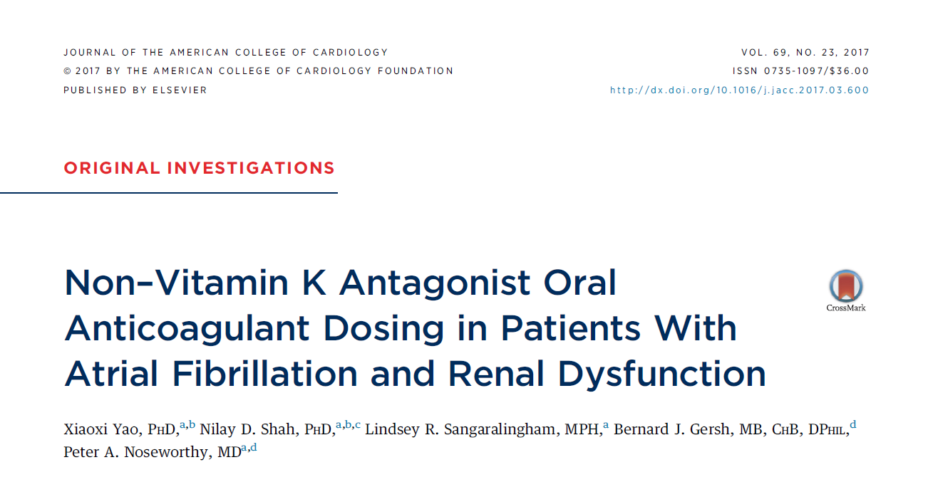
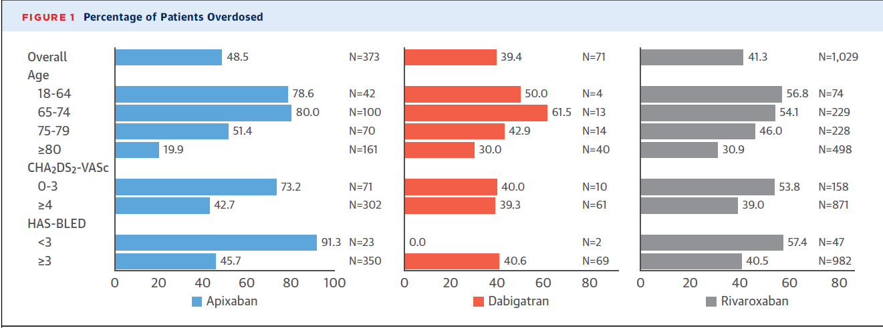
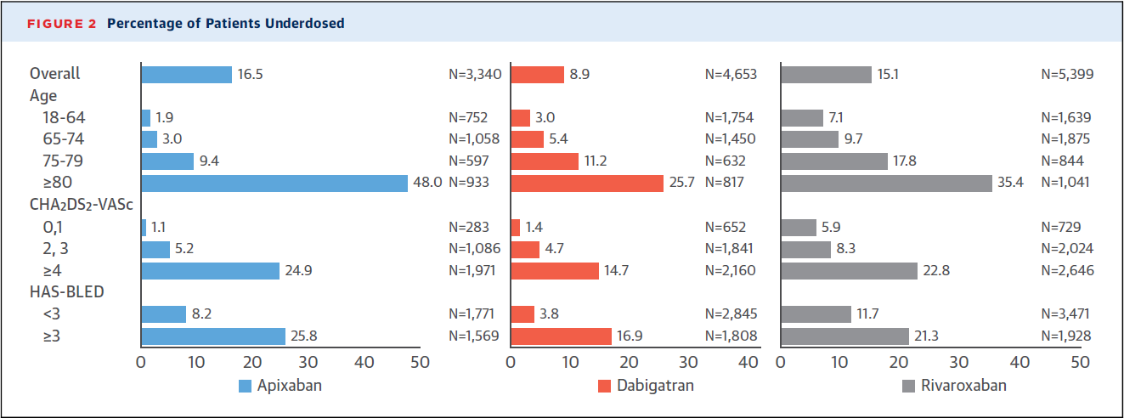
N=14.865 pacientes
Yao X. J Am Coll Cardiol 2017;69:2779-2790.
“No disponemos de estudios head-to-head, por lo que no se deben hacer comparaciones directas entre los distintos fármacos”
Notes:
BACKGROUND:
Dose reduction of non-vitamin K antagonist oral anticoagulants (NOACs) is indicated in patients with atrial fibrillation (AF) with renal impairment. Failure to reduce the dose in patients with severe kidney disease may increase bleeding risk, whereas dose reductions without a firm indication may decrease the effectiveness of stroke prevention.
OBJECTIVES:
The goal of this study was to investigate NOAC dosing patterns and associated outcomes, i.e., stroke (ischemic stroke and systemic embolism) and major bleeding in patients treated in routine clinical practice.
METHODS:
Using a large U.S. administrative database, 14,865 patients with AF were identified who initiated apixaban, dabigatran, or rivaroxaban between October 1, 2010, and September 30, 2015. We examined use of a standard dose in patients with a renal indication for dose reduction (potential overdosing) and use of a reduced dose when the renal indication is not present (potential underdosing). Cox proportional hazards regression was performed in propensity score-matched cohorts to investigate the outcomes.
RESULTS:
Among the 1,473 patients with a renal indication for dose reduction, 43.0% were potentially overdosed, which was associated with a higher risk of major bleeding (hazard ratio: 2.19; 95% confidence interval: 1.07 to 4.46) but no statistically significant difference in stroke (3 NOACs pooled). Among the 13,392 patients with no renal indication for dose reduction, 13.3% were potentially underdosed. This underdosing was associated with a higher risk of stroke (hazard ratio: 4.87; 95% confidence interval: 1.30 to 18.26) but no statistically significant difference in major bleeding in apixaban-treated patients. There were no statistically significant relationships in dabigatran- or rivaroxaban-treated patients without a renal indication.
CONCLUSIONS:
In routine clinical practice, prescribed NOAC doses are often inconsistent with drug labeling. These prescribing patterns may be associated with worse safety with no benefit in effectiveness in patients with severe kidney disease and worse effectiveness with no benefit in safety in apixaban-treated patients with normal or mildly impaired renal function.
40

Slide 41
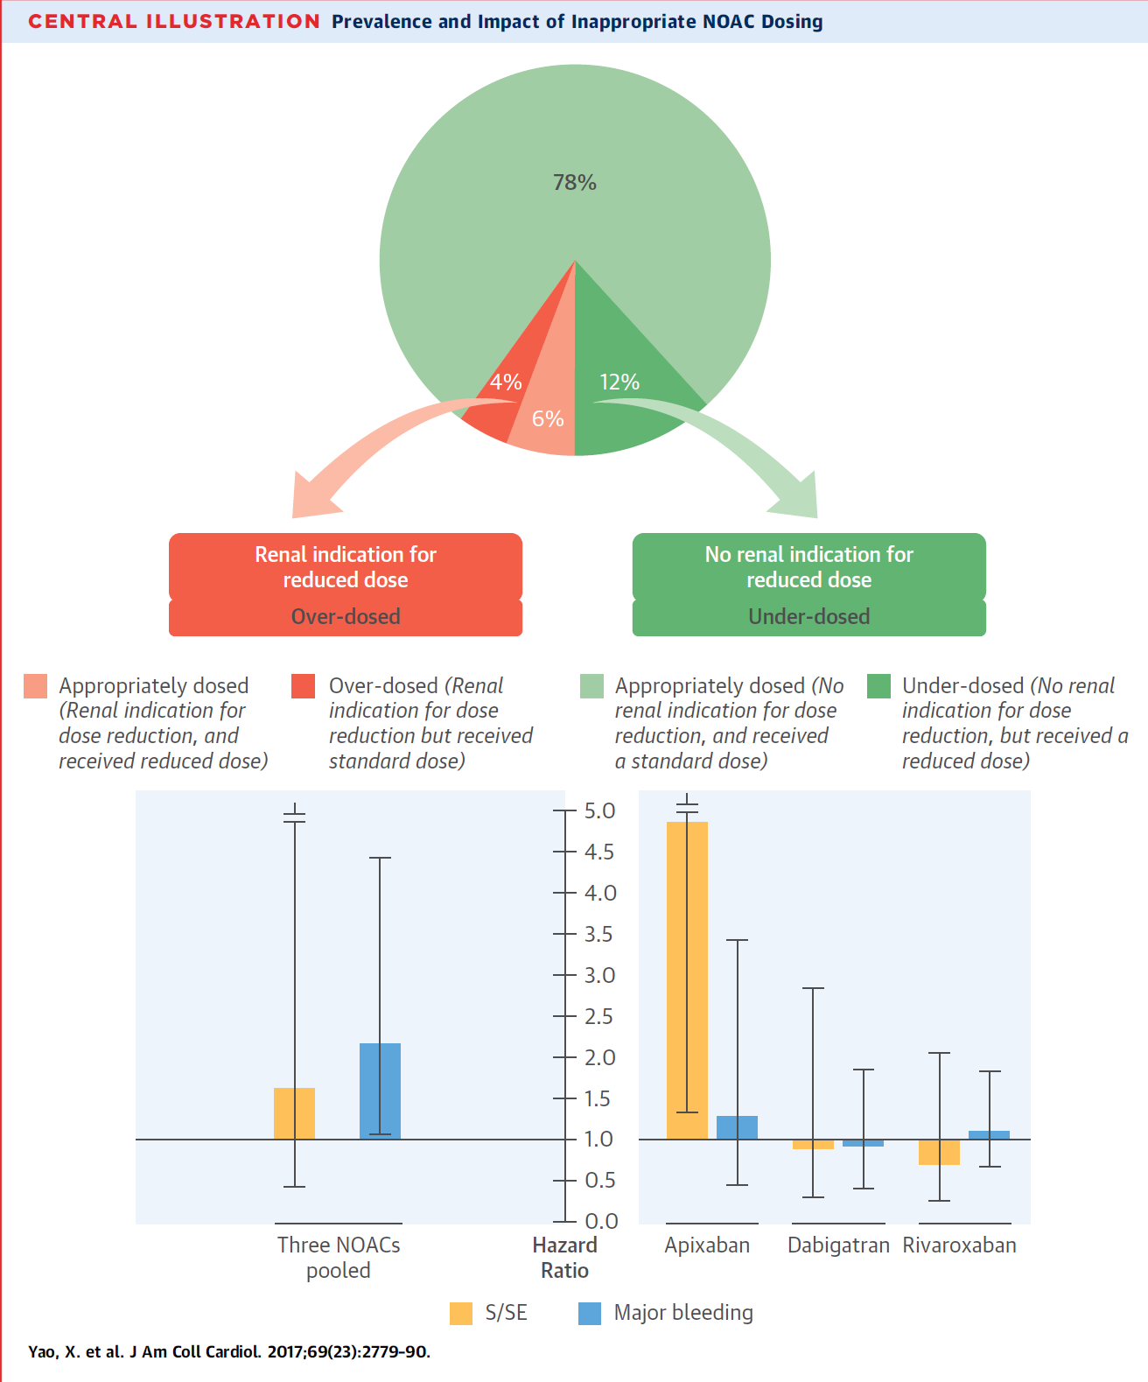
Notes:
Appropriate dosing is an essential issue to be addressed when using NOACs in patients with CKD (Figure 4). While rivaroxaban, apixaban, and edoxaban doses were reduced according to renal function in their respective randomized clinical trials (RCTs), patients in the RE-LY trial were randomized to dabigatran 150mg BID or 110mg BID without dose reduction for renal insufficiency. Per SmPc, a recommendation for the use of dabigatran 110mg BID is made in patients with CrCl< 50mL/min at high risk of bleeding. With the availability of three FXa inhibitors with less pronounced renal clearance, the use of the latter may be preferred in this patient population. The use of NOAC doses inconsistent with drug labelling has been associated with worse outcome; for example, underdosing of apixaban in patients with normal or only mildly reduced renal function has been associated with less effectiveness (i.e. higher stroke rates) and no additional safety benefit in a large ‘real-world’ AF cohort.202

Slide 42
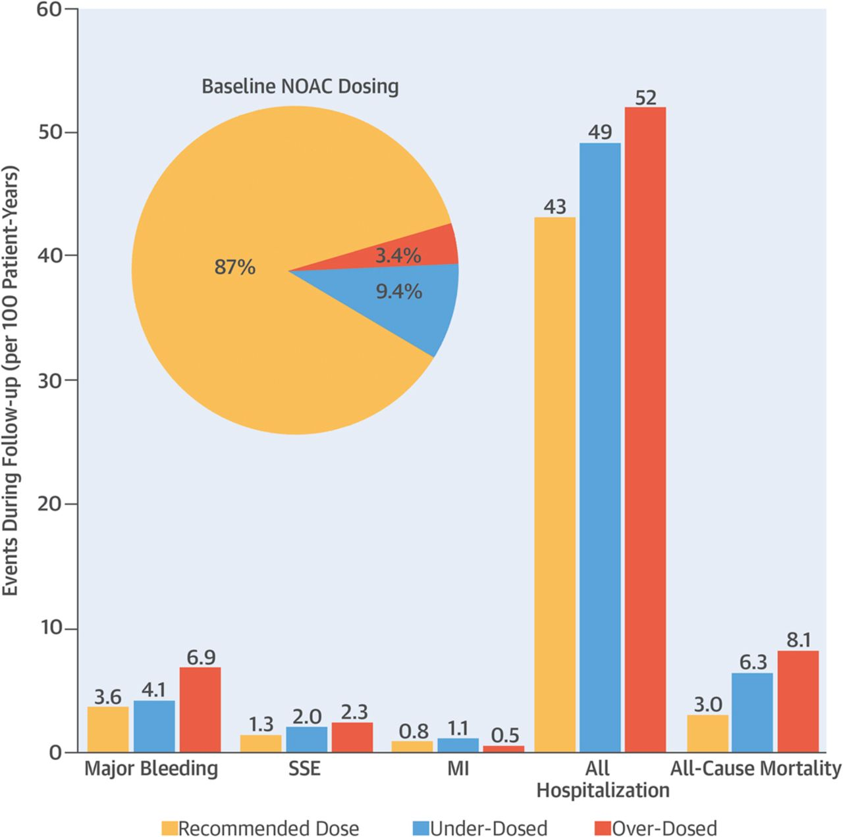
N=5.738 pacientes
Steinberg BA. JACC 2016;68:2597-2604
Notes:
Background Although non-vitamin K antagonist oral anticoagulants (NOACs) do not require frequent laboratory monitoring, each compound requires dose adjustments on the basis of certain clinical criteria.
Objectives This study assessed the frequency of off-label NOAC doses among AF patients and the associations between off-label dose therapy and clinical outcomes in community practice.
Methods We evaluated 5,738 patients treated with a NOAC at 242 ORBIT-AF II (Outcomes Registry for Better Informed Treatment of Atrial Fibrillation phase II) sites. NOAC doses were classified as either underdosed or overdosed, consistent with Food and Drug Administration labeling. Longitudinal outcomes (median follow-up: 0.99 years) included stroke or systemic embolism, myocardial infarction, major bleeding (International Society of Thrombosis and Haemostasis criteria), cause-specific hospitalization, and all-cause mortality.
Results Overall, 541 NOAC-treated patients (9.4%) were underdosed, 197 were overdosed (3.4%), and 5,000 were dosed according to U.S. labeling (87%). Compared with patients receiving the recommended dose, those who were receiving off-label doses were older (median: 79 and 80 years of age vs. 70 years of age, respectively; p < 0.0001), more likely female (48% and 67% vs. 40%, respectively; p < 0.0001), less likely to be treated by an electrophysiologist (18% and 19% vs. 27%, respectively; p < 0.0001), and had higher CHA₂DS₂-VASc scores (96% and 97% ≥2 vs. 86%, respectively; p < 0.0001) and higher ORBIT bleeding scores (25% and 31% >4 vs. 11%, respectively; p < 0.0001). After dose adjustment, NOAC overdosing was associated with increased all-cause mortality compared with recommended doses (adjusted hazard ratio: 1.91; 95% confidence interval [CI]: 1.02 to 3.60; p = 0.04). Underdosing was associated with increased cardiovascular hospitalization (adjusted hazard ratio: 1.26; 95% CI: 1.07 to 1.50; p = 0.007).
Conclusions A significant minority (almost 1 in 8) of U.S. patients in the community received NOAC doses inconsistent with labeling. NOAC over- and underdosing are associated with increased risk for adverse events. (Outcomes Registry for Better Informed Treatment of Atrial Fibrillation II [ORBIT-AF II]
42

Slide 43
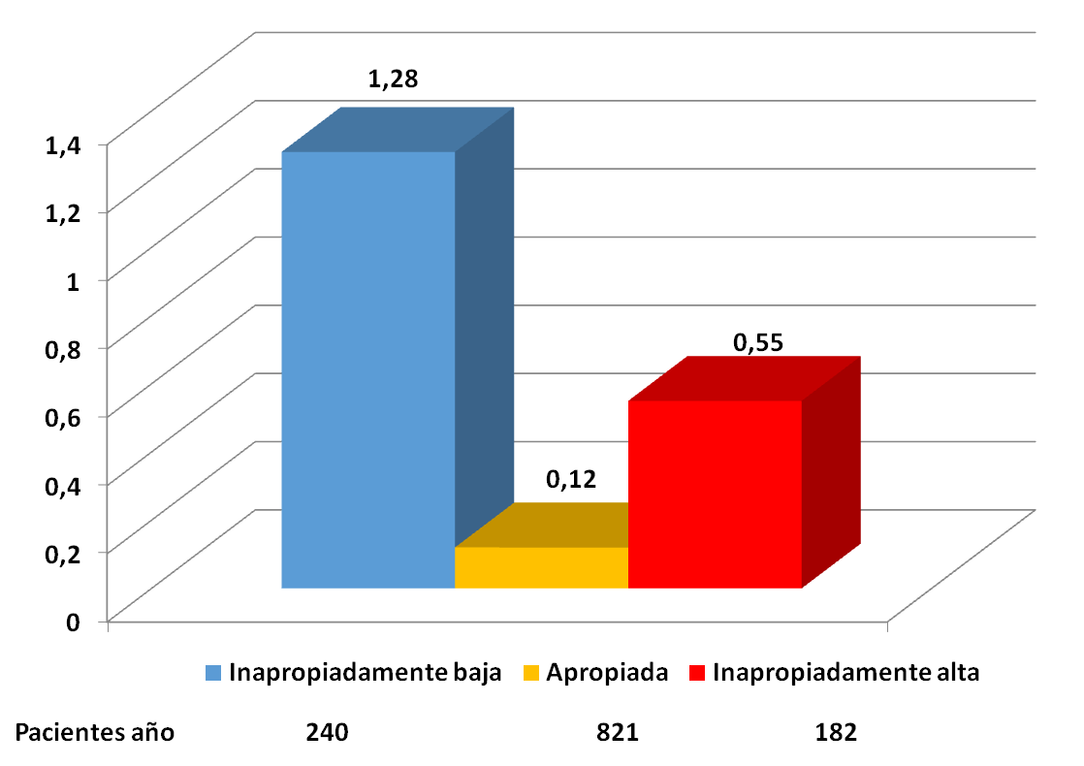
Resultados: datos relacionados con la FA
Resultados: Ictus
p=0.01
Eventos/100 pacientes año
p=0.24
Ruiz Ortiz M. Rev Esp Cardiol 2020;73(4):329-330

Slide 44
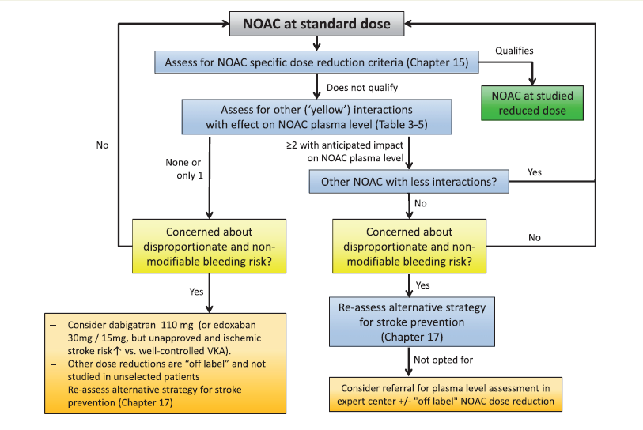
Steffel J. Eur Heart J 2018;39:1330-1393

Slide 45
Fibrilación auricular y procedimientos invasivos o quirúrgicos… ¿hay que suspender la anticoagulación siempre? ¿cuánto tiempo? ¿hay que usar terapia puente?

Slide 46
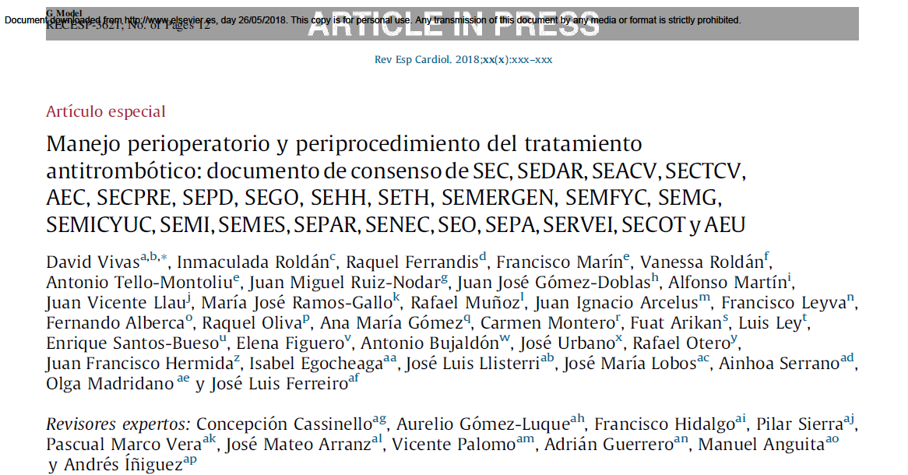
Vivas D. Rev Esp Cardiol 2018. https://doi.org/10.1016/j.recesp.2018.01.001

Slide 47

Vivas D. Rev Esp Cardiol 2018. https://doi.org/10.1016/j.recesp.2018.01.001

Slide 48

Vivas D. Rev Esp Cardiol 2018. https://doi.org/10.1016/j.recesp.2018.01.001

Slide 49
Vivas D. Rev Esp Cardiol 2018. https://doi.org/10.1016/j.recesp.2018.01.001

Slide 50


Vivas D. Rev Esp Cardiol 2018. https://doi.org/10.1016/j.recesp.2018.01.001

Slide 51

Vivas D. Rev Esp Cardiol 2018. https://doi.org/10.1016/j.recesp.2018.01.001

Slide 52
Caso 3
Mujer de 66 años, obesa (110kg/157 cm), DM, HTA y dislipemia
AIT isquémico en marzo 2000.
Cierre de foramen oval permeable en Septiembre 2002
FA paroxística desde abril 2005. Anticoagulada inicialmente con acenocumarol y posteriormente con Dabigatrán 110 mg/12h
Nuevo AIT isquémico en Junio 2014, estando correctamente tratada con Dabigatrán 110 mg/12h. Se subió Dabigatrán a 150 mg/12h, que no toleró por dispepsia y se cambió a Apixabán 5 mg 1 c/12h.

Slide 53
Caso 3
En Febrero 2018 hemorragia intradural espontánea con mielopatía, estaba con Apixabán 5 mg 1 c/d.
Arteriografía: no MAV o fístulas. Tras control de neuroimagen se inició Hibor 3500 UI/sc/24h al mes del alta.
En C Ext de Cardiología (Noviembre 2019) se suspende Hibor y se consulta a Neurología la posibilidad de reintroducir ACOD, pero tras nueva RM de médula, se contraindica definitivamente la anticoagulación.
Se decide cierre percutáneo de orejuela (10 julio 2020) con tratamiento con AAS por 3 meses. Ahora sin tratamiento.

Slide 54
¿Cuándo no deberíamos anticoagular una fibrilación auricular?

Slide 55
¿Cuándo no deberíamos anticoagular una fibrilación auricular?
Hindricks G. 2020 ESC guidelines for AF management. European Heart Journal 2020;42:373-498.

Slide 56
¿Cuándo no deberíamos anticoagular una fibrilación auricular?
“The few absolute contraindications to OAC include:
active serious bleeding (where the source should be identified and treated),
associated comorbidities (e.g. severe thrombocytopenia
<50x 10³platelets/lL, severe anaemia under investigation, etc.); or
a recent high-risk bleeding event such as intracranial haemorrhage (ICH).”
Hindricks G. 2020 ESC guidelines for AF management. European Heart Journal 2020;42:373-498.

Slide 57
¿Qué hacer ante un proceso hemorrágico? ¿Supresión o continuación?

Slide 58
Sangrados menores
Pueden provocar interrupciones, que pueden aumentar el riesgo trombótico.
Se suelen poder manejar retrasando o “saltándose” no más de una dosis
Si no ceden… tratar la causa:
    Inhibidores de la bomba de protones para úlcera péptica
    Antibióticos para infección urinaria.
    Antifibrinolíticos locales para sangrados nasales o de encías.
Cambiar de fármaco anticoagulante.
Sospechas de sangrado oculto… (anemias.. .) investigar siempre la etiología.

Slide 59
Hindricks G. 2020 ESC guidelines on AF management. Eur Heart J 2020;42:373-498

Slide 60

Steffel J. Eur Heart J 2018;39:1330-1393
Notes:
The Phase III NOAC studies have consistently shown that NOACs cause less intracranial and less life-threatening bleedings than warfarin, despite the absence of reversal strategies in these trials. Not only was there similar or even a reduced bleeding incidence, but patients experiencing a major (particularly extracranial) bleeding under NOACs were also shown to have a more favourable outcome than for bleeding under VKA treatment.240,242–245,378,379
As exemplified for GI bleedings, i.e. one of the most frequently encountered bleeds, many additional factors need to be taken into consideration (Figure 7). Particularly for severe and life-threatening bleedings without a clear secondary or reversible/treatable cause the risks of re-initiating anticoagulation may outweigh the benefits. In such cases, implantation of a left atrial appendage (LAA) occluder or surgical LAA occlusion may be considered as a potential substitute for long-term anticoagulation.3 However, RCT evidence for LAA occlusion after bleeding under OAC is missing, which is why, ideally, treatment should occur wherever possible in the framework of a randomized trial to contribute to evidence for this difficult to treat population.

Slide 61


Loffredo L. Dig Liver Dis 2015;47:429-31.
Notes:
tBackground: New oral anticoagulants represent an alternative to standard therapy with vitamin K antag-onists but data regarding gastrointestinal bleeding are still unclear.Aims: To investigate if new oral anticoagulants are associated with an enhanced risk of gastrointestinalbleeding vs warfarin in patients with atrial fibrillation.Methods: Meta-analysis of phase three randomized controlled trials to compare the incidence of gastroin-testinal bleeding in atrial fibrillation patients treated with new oral anticoagulants (apixaban, dabigatran,edoxaban and rivaroxaban) vs warfarin.Results: Four studies including 71,302 patients were selected. Compared with warfarin, new oral anticoag-ulants significantly increased gastrointestinal bleeding (RR: 1.23; 95% CI 1.03–1.46; p = 0.01). Rivaroxaban(RR: 1.46; 95% CI 1.2–1.8; p < 0.001) and high dosages of edoxaban (RR: 1.22; 95% CI 1.01–1.47; p = 0.038)and dabigatran (RR: 1.50; 95% CI 1.20–1.88; p < 0.001) significantly increased gastrointestinal bleedingwhile a null effect was detected with apixaban.Conclusions: This meta-analysis suggests that rivaroxaban and high dosages of dabigatran and edoxabanshould be avoided in patients at high risk of gastrointestinal bleeding.
61

Slide 62
Hindricks G. 2020 ESC guidelines for AF management. European Heart Journal 2020;42:373-498.

Slide 63
¿Cuál es el papel del cierre percutáneo de orejuela auricular izquierda en estos pacientes?

Slide 64

Notes:
Periprocedural major adverse events (including pericardial bleeding/tamponade, stroke, device embolisation, etc., occurred in 5-7% of patients in PROTECT AF and other studies, reflecting the learning curve effect of a relatively complex procedure1,2,3,4. Indeed, the need for transseptal access, the fragility and enormous anatomical variability of the LAA placed LAA closure among the most challenging procedures, both for interventional cardiologists and for electrophysiologists. Fortunately, the results of subsequent randomised trials such as PREVAIL3 and reports from registries have documented a decrease of MAEs to 2-3% of patients6. Nevertheless, LAA closure is a preventive therapy and an even lower MAEs rate (<1%) remains the goal. This can be achieved with careful patient selection criteria, improvements in device design, advancements in cardiac imaging, and, more importantly, by following specific guidelines regarding physician training and certification to perform LAA closure procedures7

Slide 65
Hindricks G. 2020 ESC guidelines on AF management. Eur Heart J 2020;42:373-498

Slide 66
Anticoagulación en la FANV: casos clínicos.
1. En pacientes ancianos y frágiles, mejor ACOD que AVK (indicación clase I).
Usar siempre dosis apropiadas según ficha técnica.
2. No anticoagular CHA2DS2VASc 0 o contradicaciones absolutas (que son pocas)
3. Fibrilación auricular e insuficiencia renal moderada… ANTICOAGULAR
Fibrilación auricular e insuficiencia renal terminal (HD)… individualizar.
4. Fibrilación auricular y procedimientos invasivos o quirúrgicos… según procedimiento, fármaco y función renal.
5. Anticoagulación y cardiopatía estructural: ACOD excepto prótesis mecánica o estenosis mitral moderada o severa
6. Ante un proceso hemorrágico: Valorar riesgo- beneficio. En algunos casos valorar cierre de orejuela.

Slide 67


¡Gracias!

